Slide 1
When students sprint: Experiences with Athletic Software Engineering
Philip Johnson
Collaborative Software Development Laboratory
Information and Computer Sciences
University of Hawaii
Honolulu, HI USA

Slide 2


Slide 3
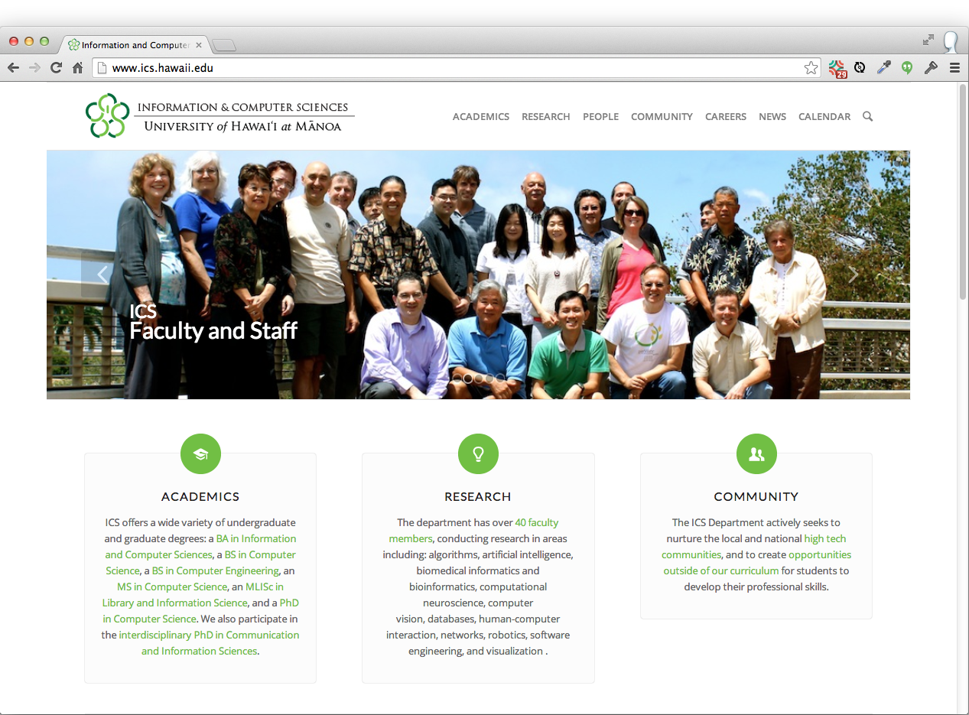

Slide 4
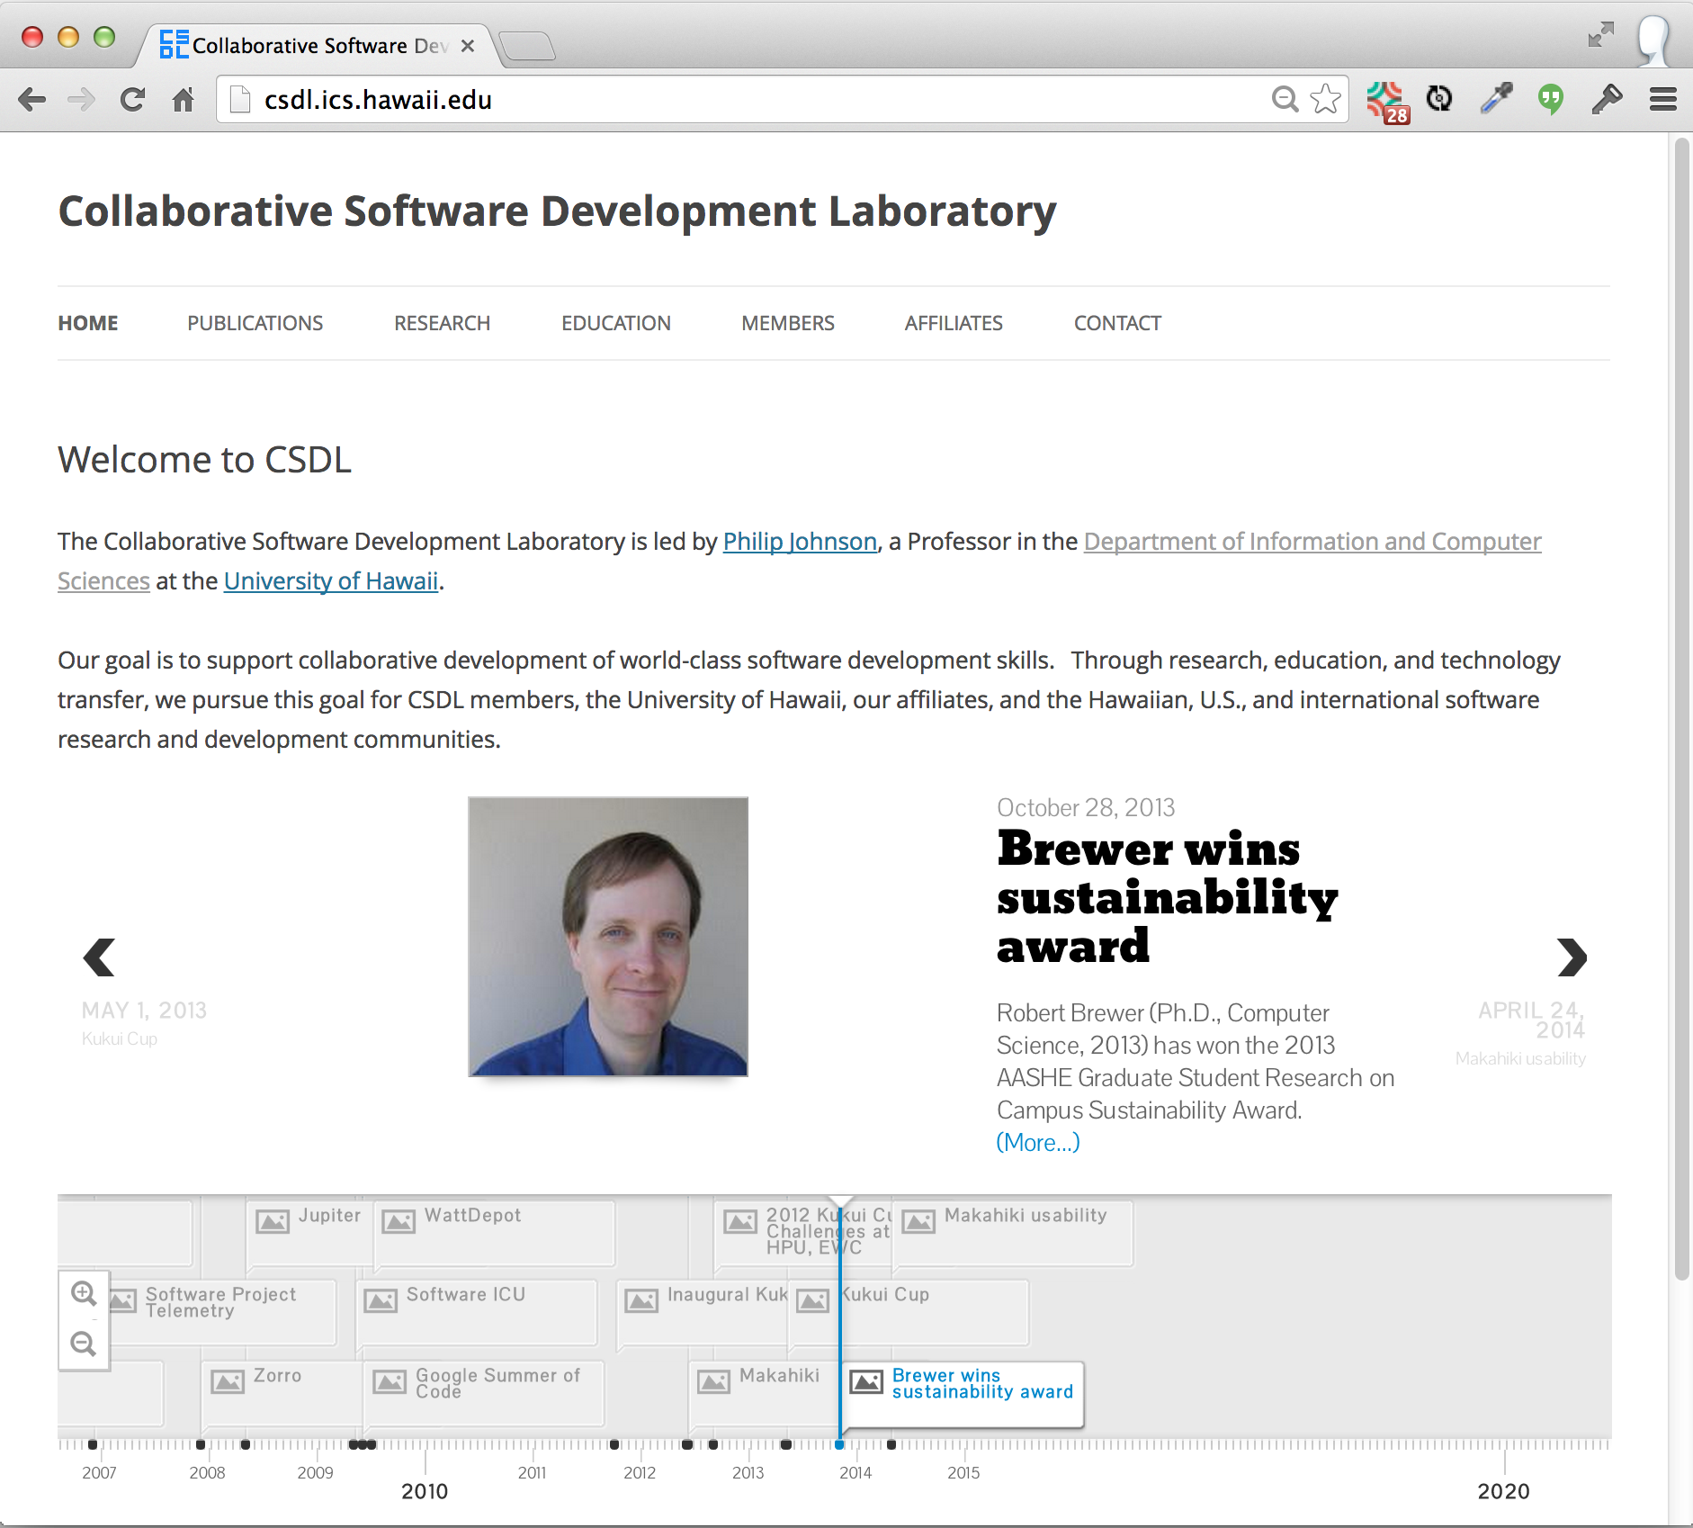

Slide 5
Learning outcomes
New ways to experiment on your students in the classroom
A simple, open source technology for building semi-structured course web sites.

Slide 6
Prelude: Bloom's Taxonomy
Capabilities
Create
Deep
Evaluate
Analyze
Apply
Understand
Remember
Shallow

Slide 7
Prelude: Bloom's Taxonomy
Capabilities
Techniques
Teach others
Create
Deep
Practice by doing
Evaluate
Discussion group
Analyze
Demonstration
Apply
Audio-Visual
Understand
Lecture/Reading
Remember
Shallow

Slide 8
Prelude: Bloom's Taxonomy
Capabilities
Techniques
Retention
Teach others
90%
Create
Deep
Practice by doing
75%
Evaluate
Discussion group
Analyze
50%
Demonstration
Apply
30%
Audio-Visual
20%
Understand
Lecture/Reading
10%
Remember
Shallow

Slide 9

Evolution of my pedagogy

Slide 10
How can I create "deep" learning in my courses?

Slide 11




Approach: Survey text + lecture

Slide 12
Result
Approach | Significant strength | Significant weakness
Survey + Lecture | High quality texts | Low engagement

Slide 13
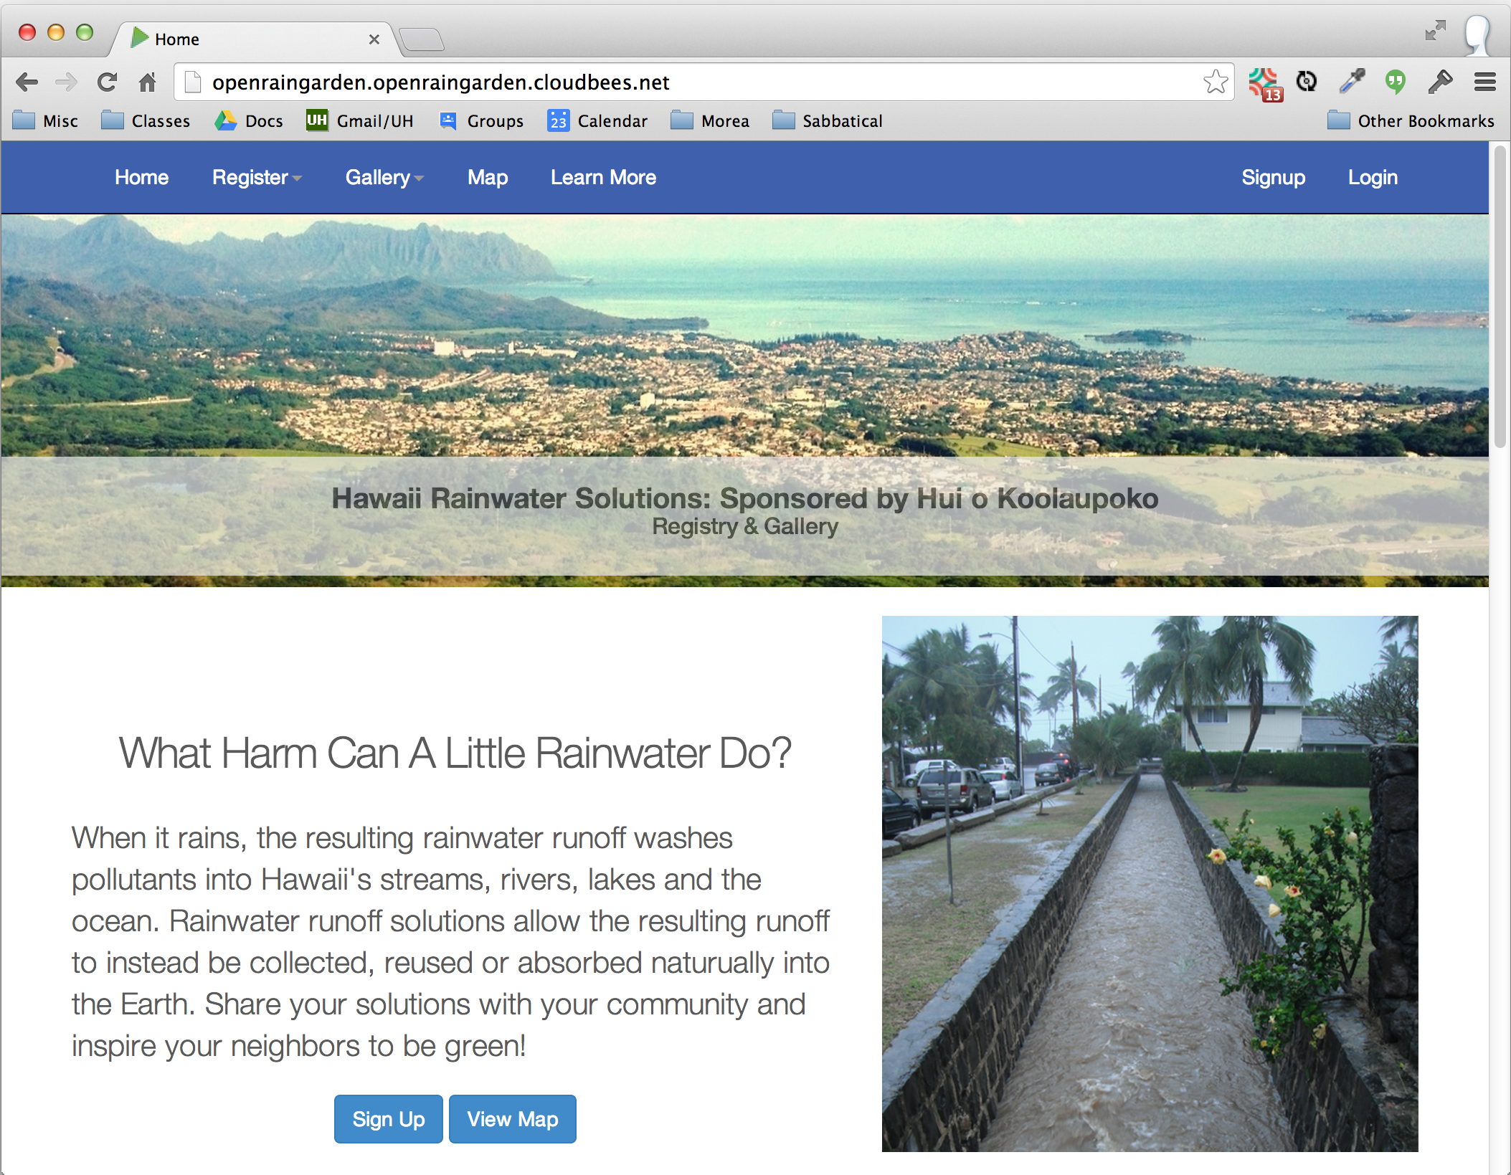
Approach: Community projects

Slide 14
Result
Approach | Significant strength | Significant weakness
Survey + Lecture | High quality texts | Low engagement
Community projects | High potential engagement | Variability in engagement

Slide 15
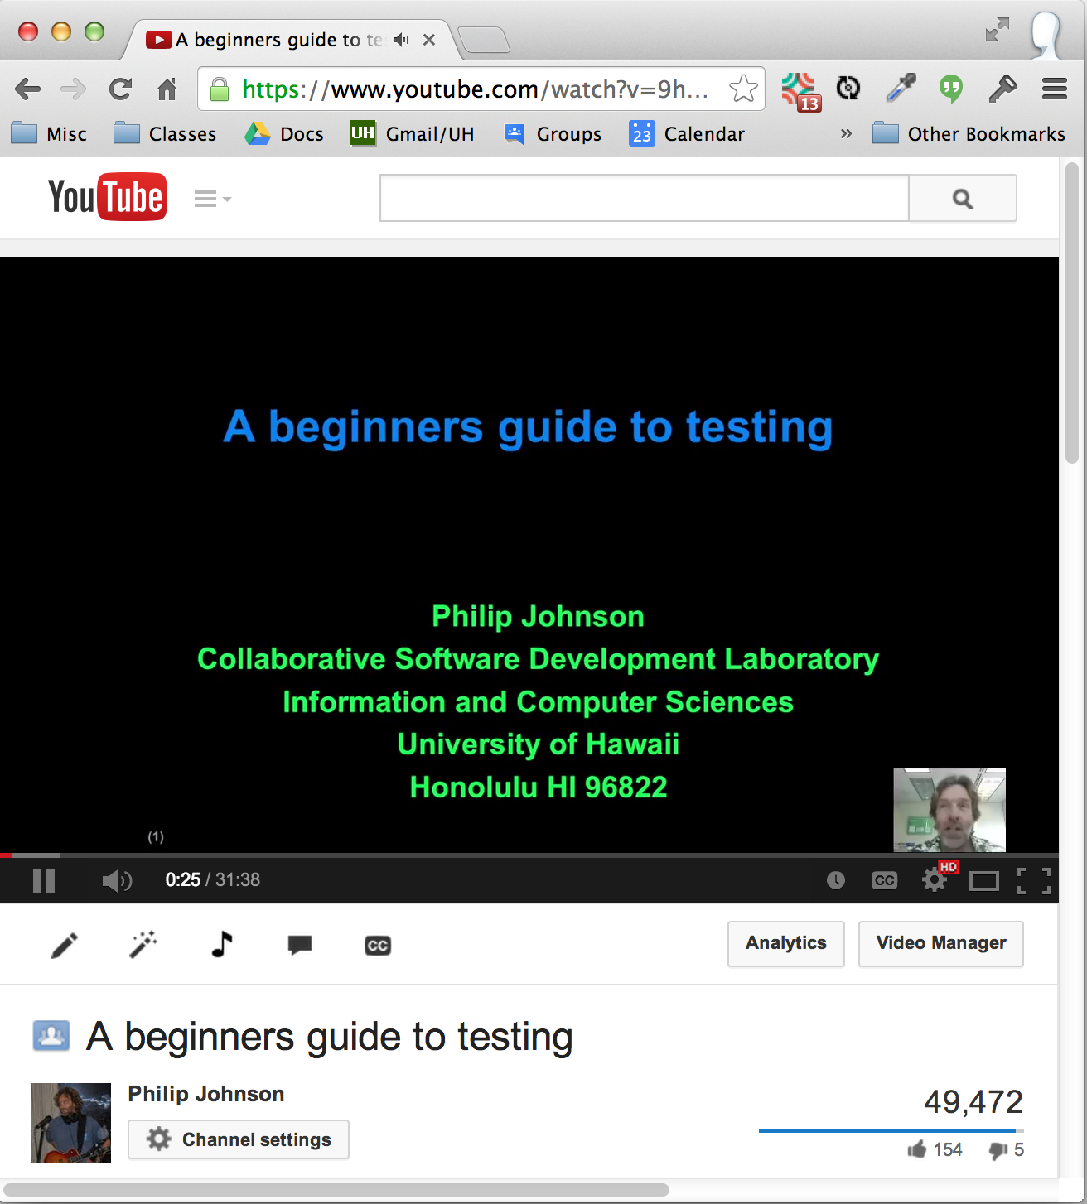
Approach: Flipped classroom

Slide 16
Result
Approach | Significant strength | Significant weakness
Survey + Lecture | High quality texts | Low engagement
Community projects | High potential engagement | Variability in engagement
Flipped classroom | "Active" classrooms | 60 min YouTube videos

Slide 17
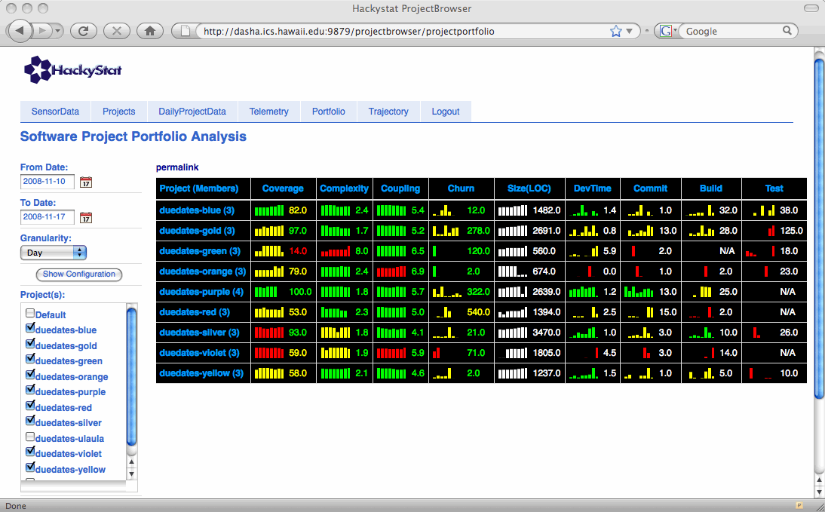
Approach: Super Metrics!

Slide 18
Result
Approach | Significant strength | Significant weakness
Survey + Lecture | High quality texts | Low engagement
Community projects | High potential engagement | Variability in engagement
Flipped classroom | "Active" classrooms | 60 min YouTube videos
Super Metrics | Fine grained insight into developer behavior | Complexity

Slide 19
Approach: Athletic Software Engineering

Slide 20
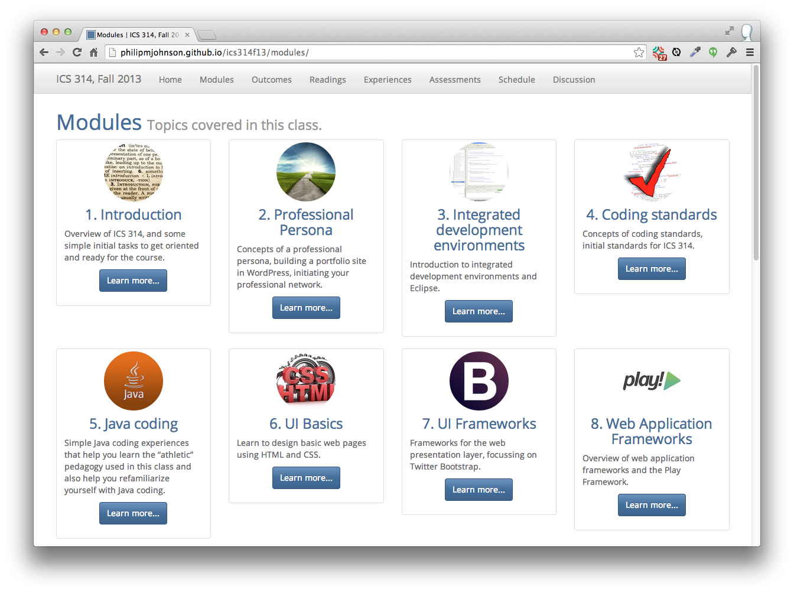

Slide 21
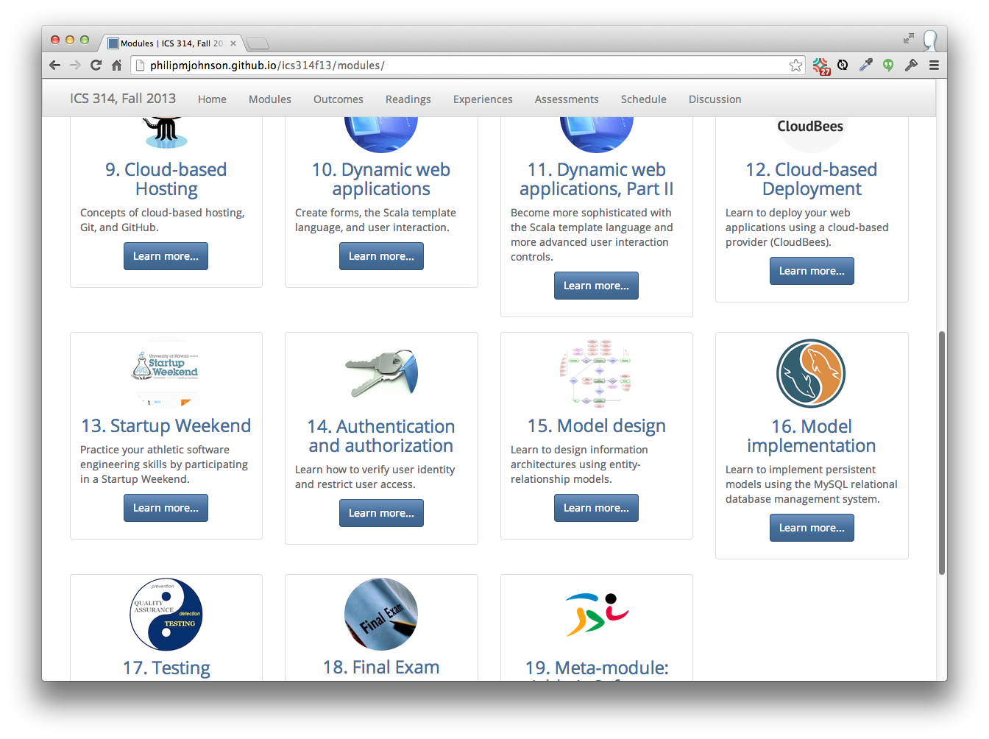

Slide 22
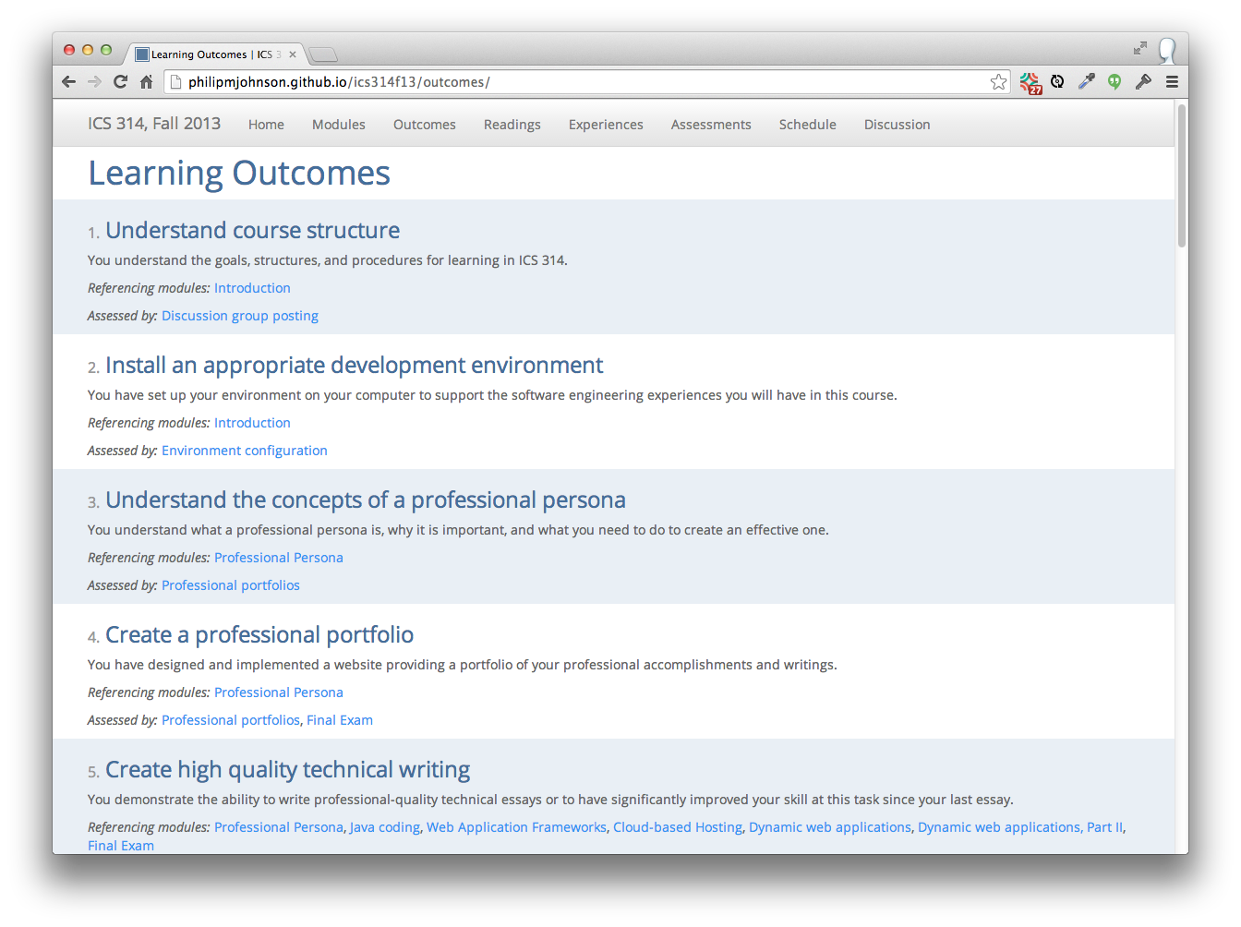

Slide 23
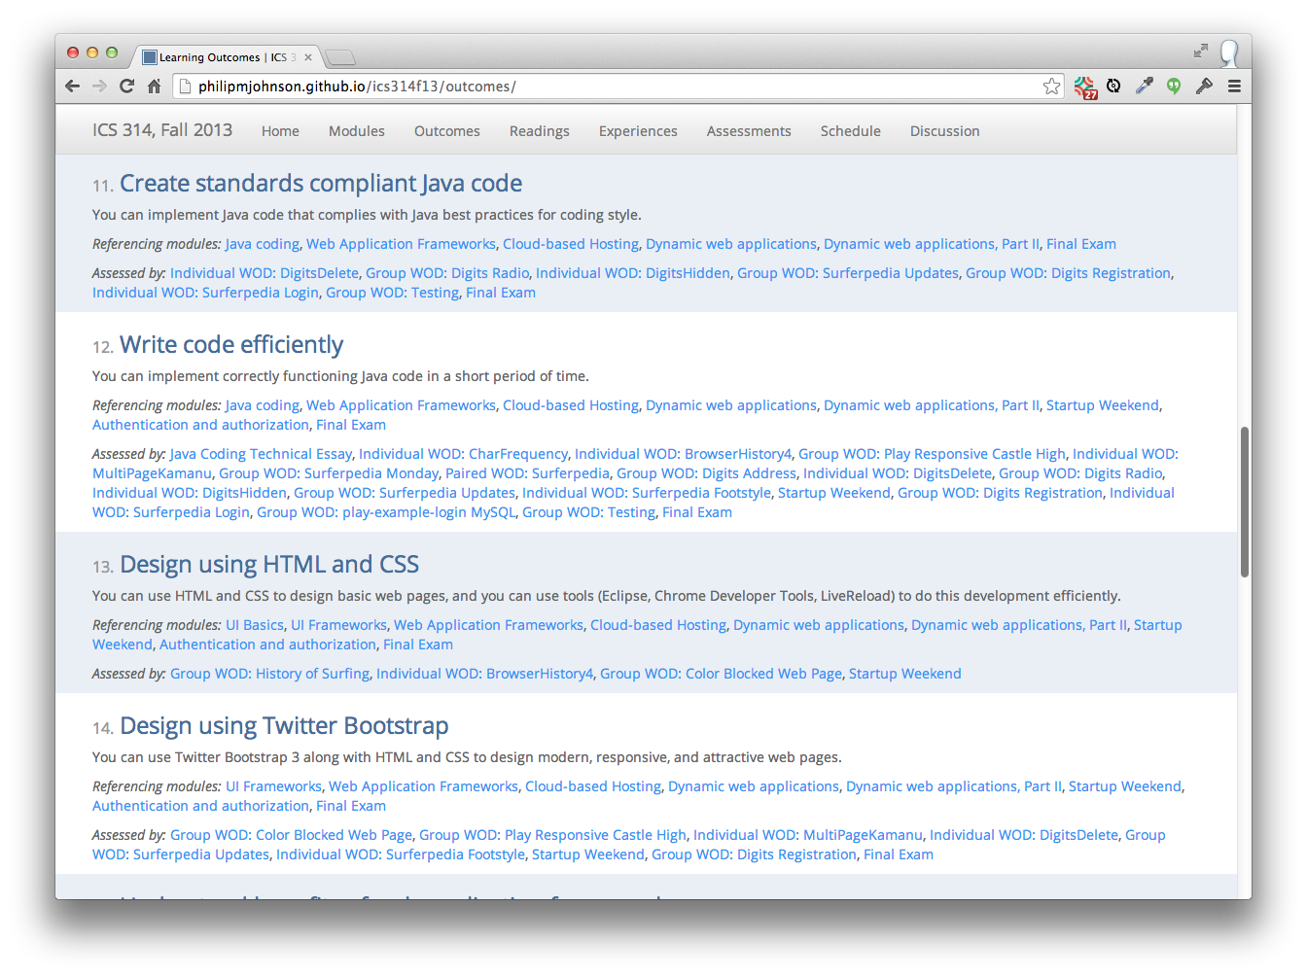

Slide 24
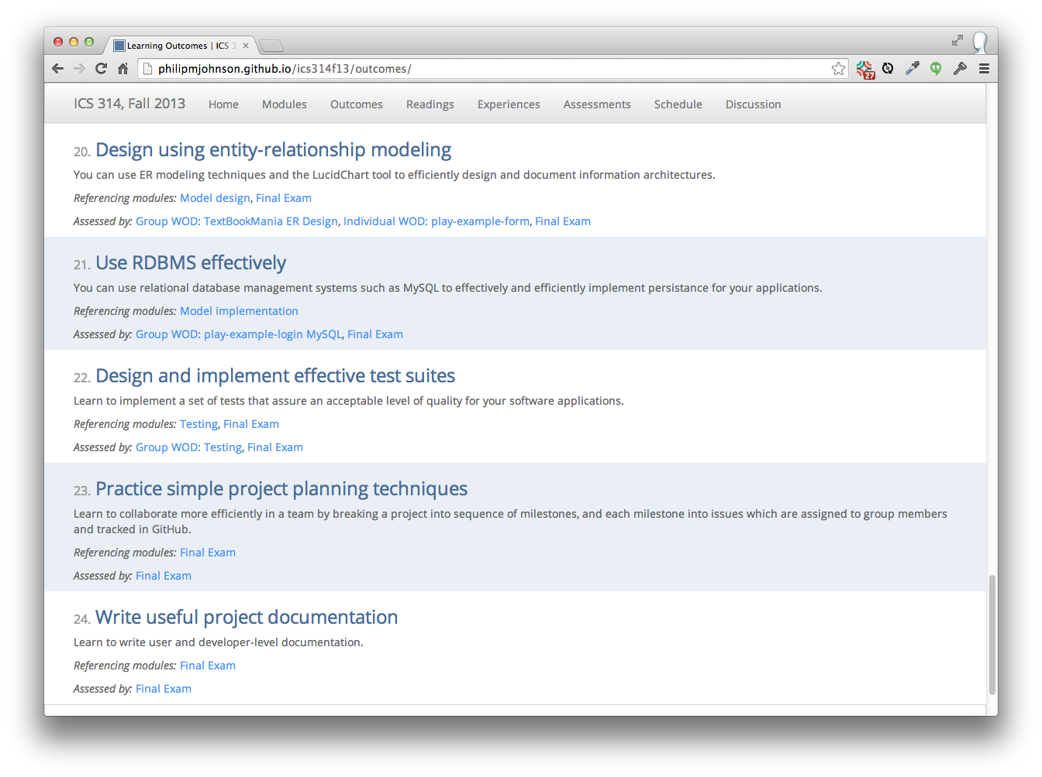

Slide 25
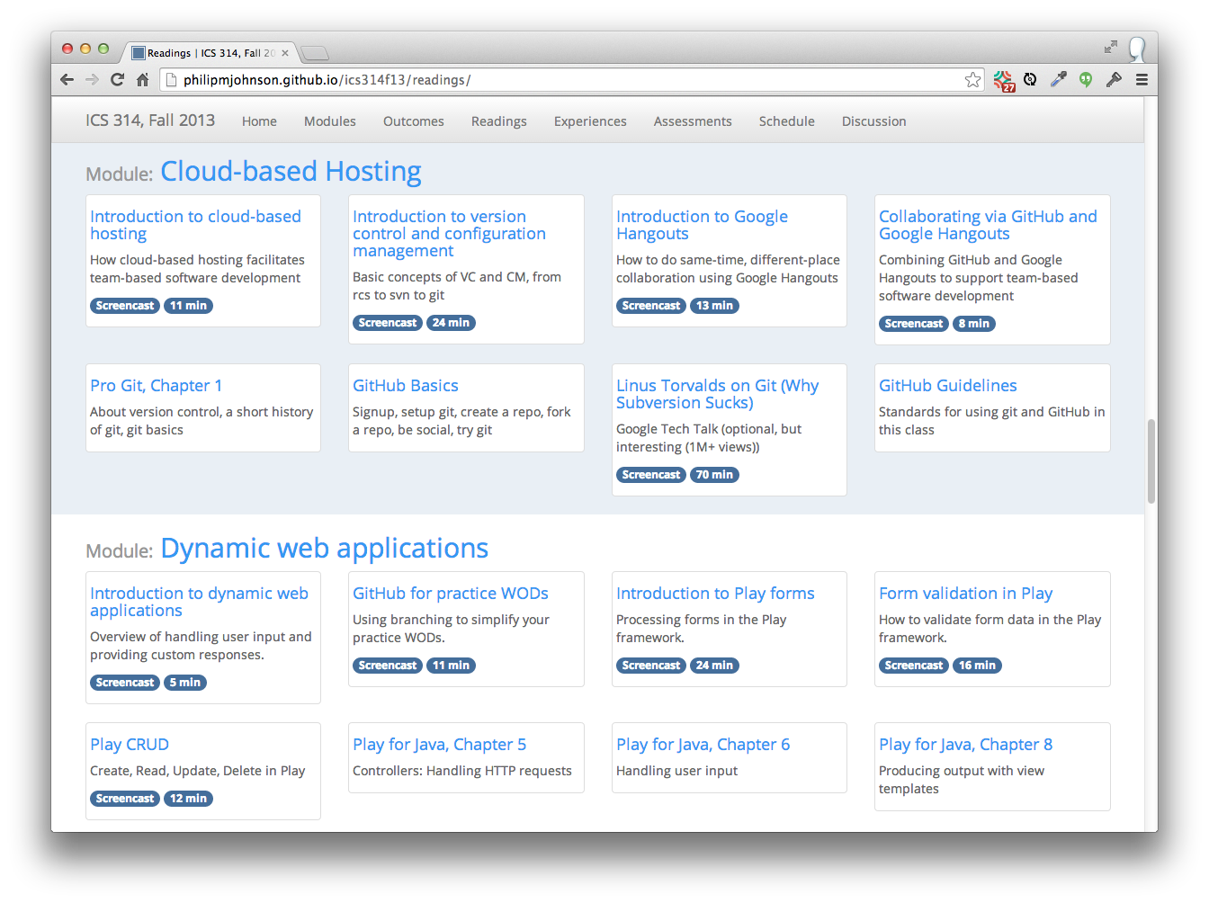

Slide 26
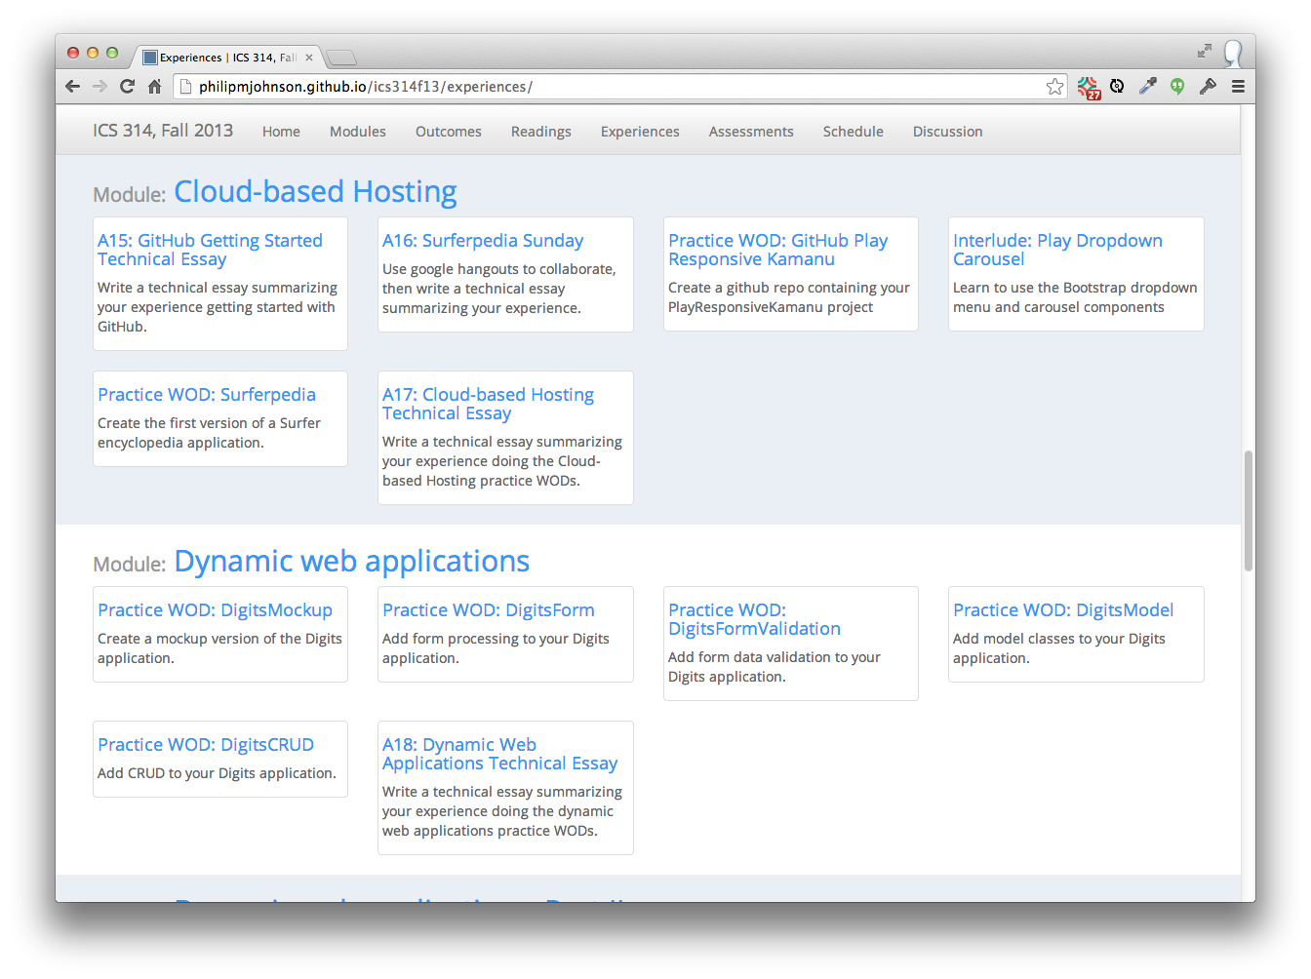

Slide 27
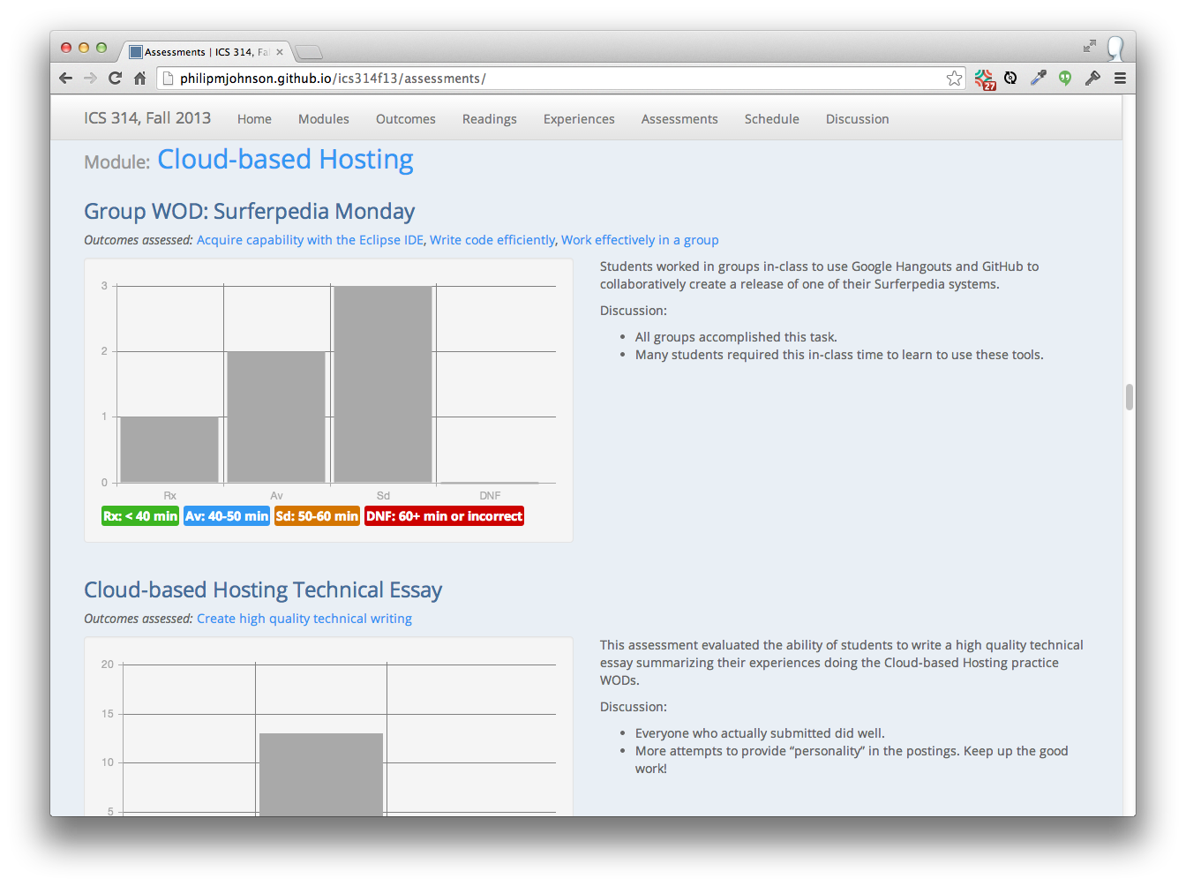

Slide 28
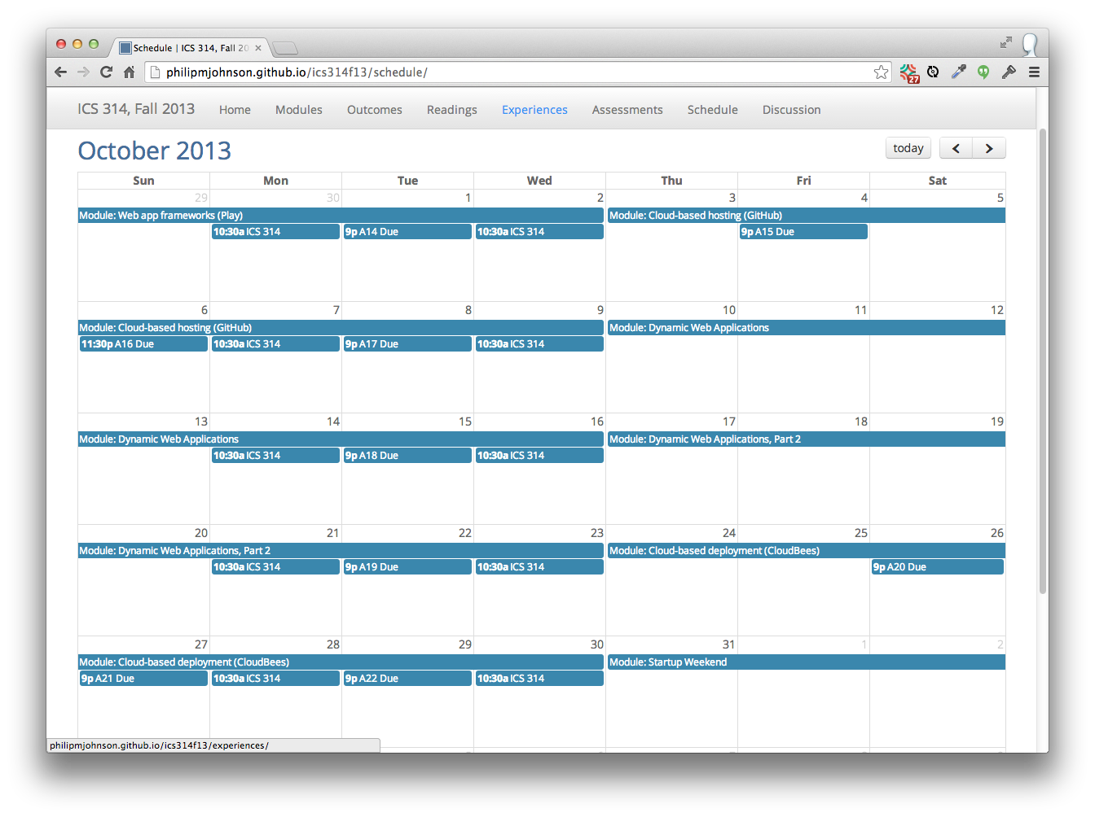

Slide 29
So, where's the "athletic"?

Slide 30
Making it athletic
"Workouts", not "classes"

Slide 31
Making it athletic
No reward for "heroic efforts"

Slide 32
Making it athletic
Organize material into "skills".
"Fluency" with a skill can be tested in <45 minutes.
Instructor demonstrates "fluency" via YouTube videos.

Slide 33
Making it athletic
"DNF" (Did not finish)
No credit if you take too long

Slide 34
Example
Skill:
Develop fluency designing responsive HTML5 user interfaces using Twitter Bootstrap

Slide 35
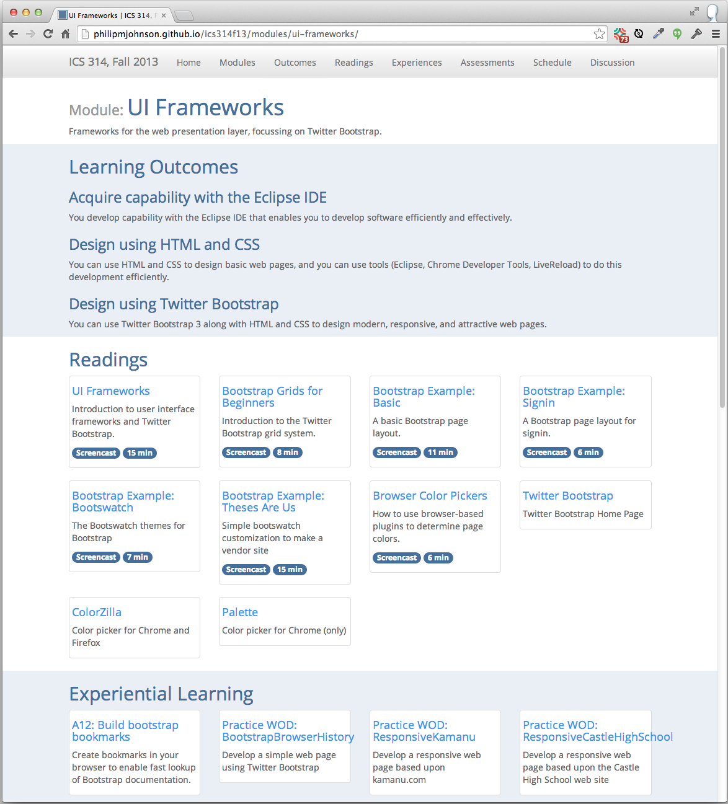

Slide 36
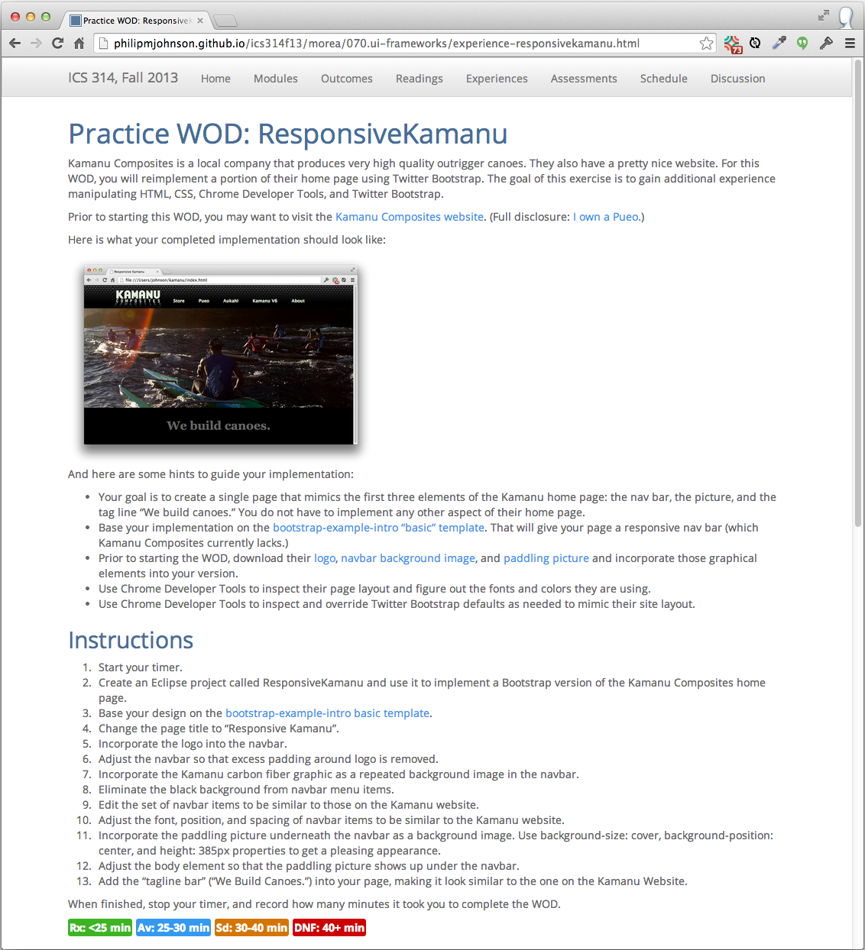

Slide 37
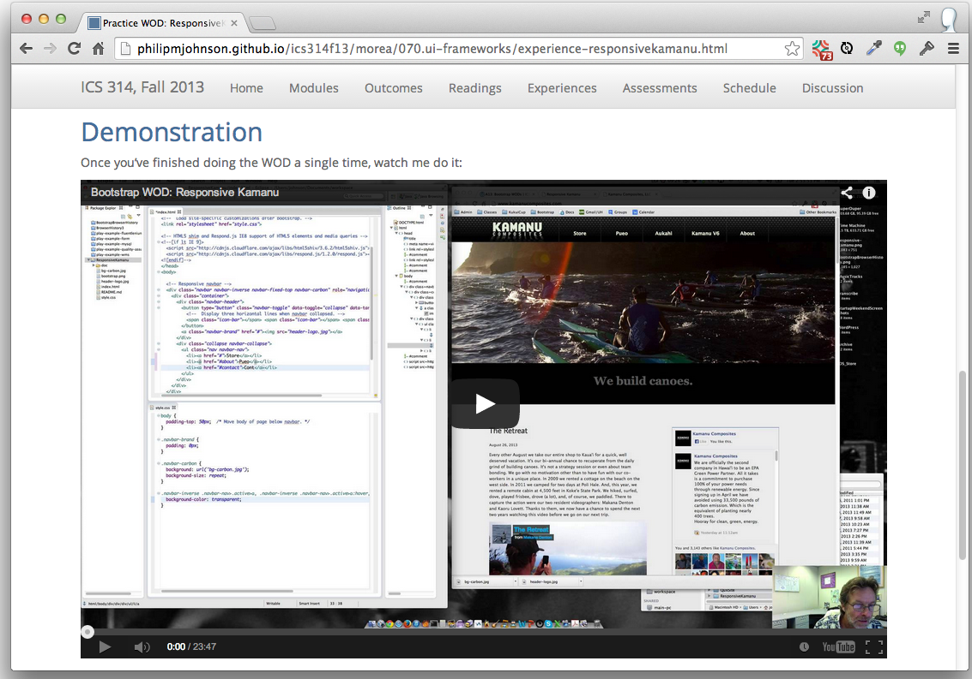

Slide 38
Question: How to assess if a student has achieved "fluency"?

Slide 39
Answer: The "WOD" (Workout of the Day)
Each Wednesday, students take a timed test to see if they have achieved "fluency" for that module
If they do not solve the problem both quickly and correctly, they get no credit for the module.

Slide 40
WOD Logistics
How do you
(1) individually time every student in the class,
(2) verify each student did the problem correctly?

Slide 41
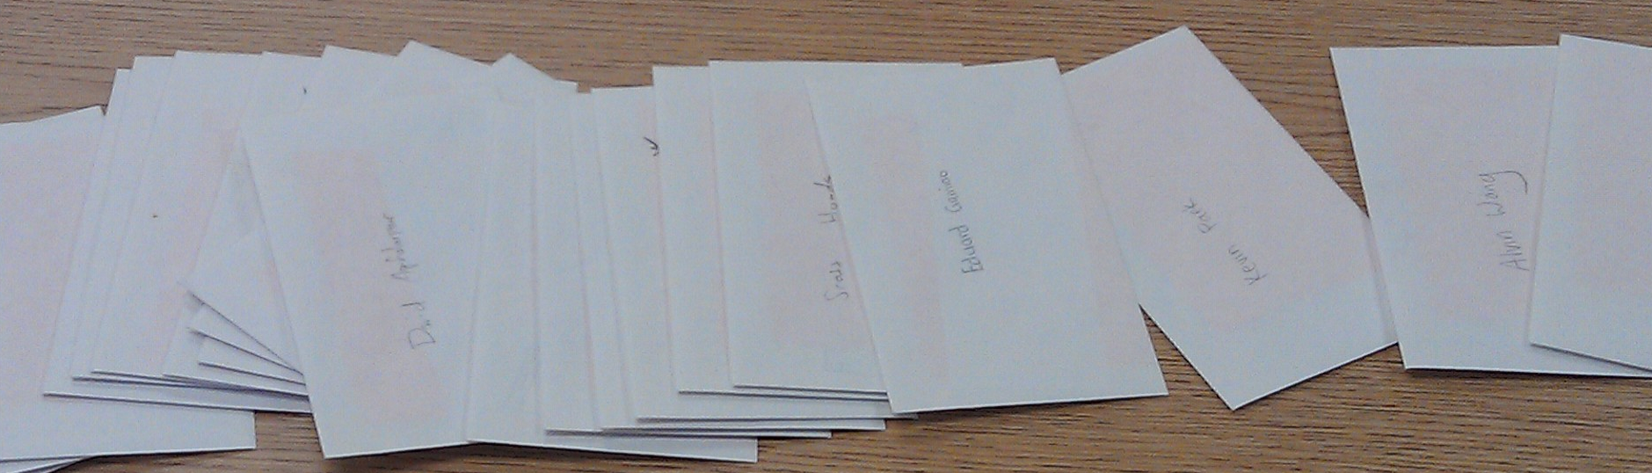
Each student has an envelope
I keep envelopes between WODs

Slide 42
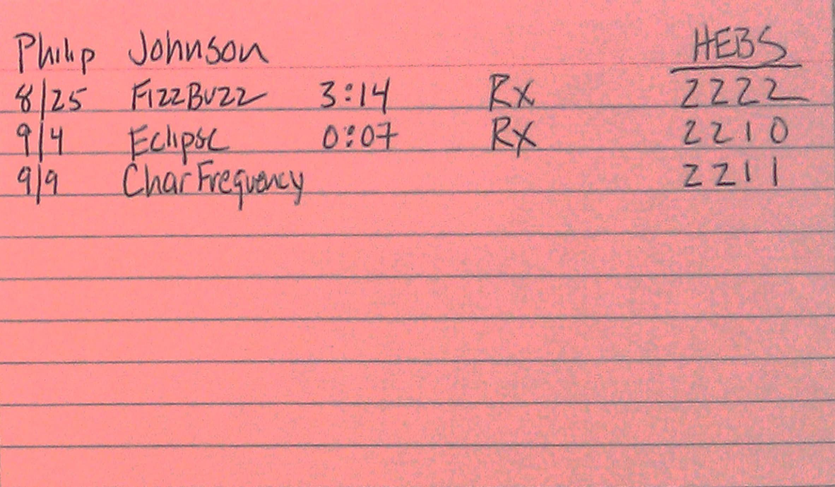
Envelopes contain index card
with results from all WODs

Slide 43
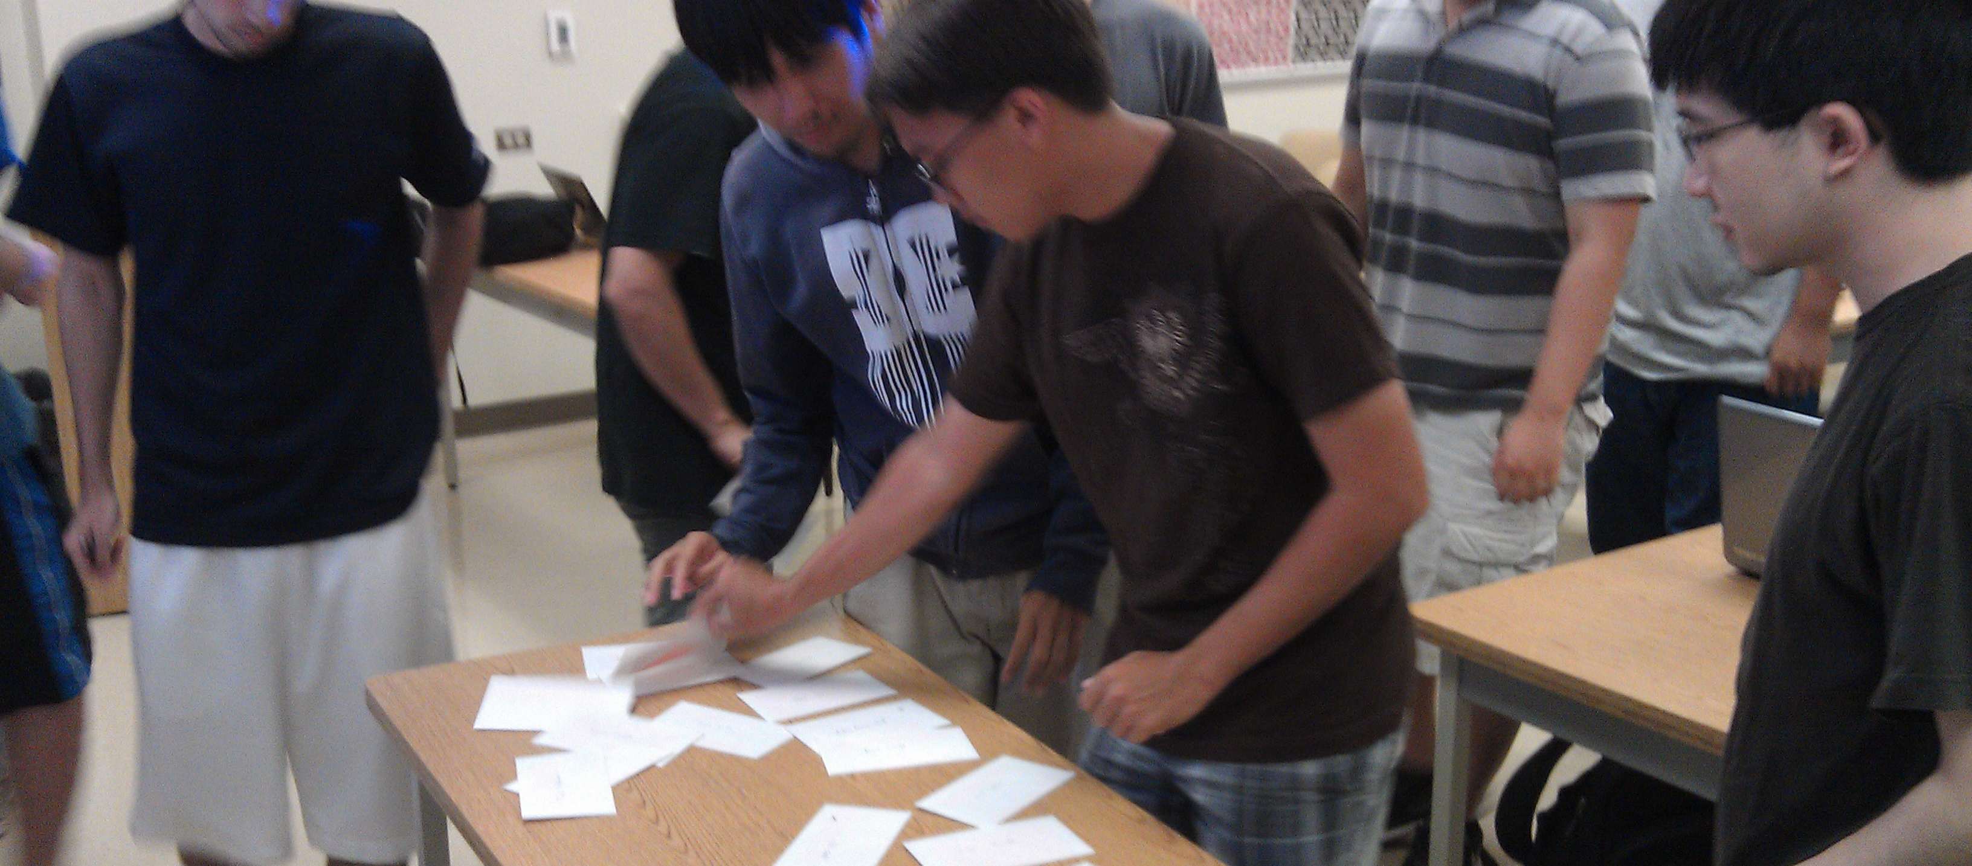
Students get their card
and write date and WOD name

Slide 44

Once class is ready: I provide URL to WOD and start timer

Slide 45
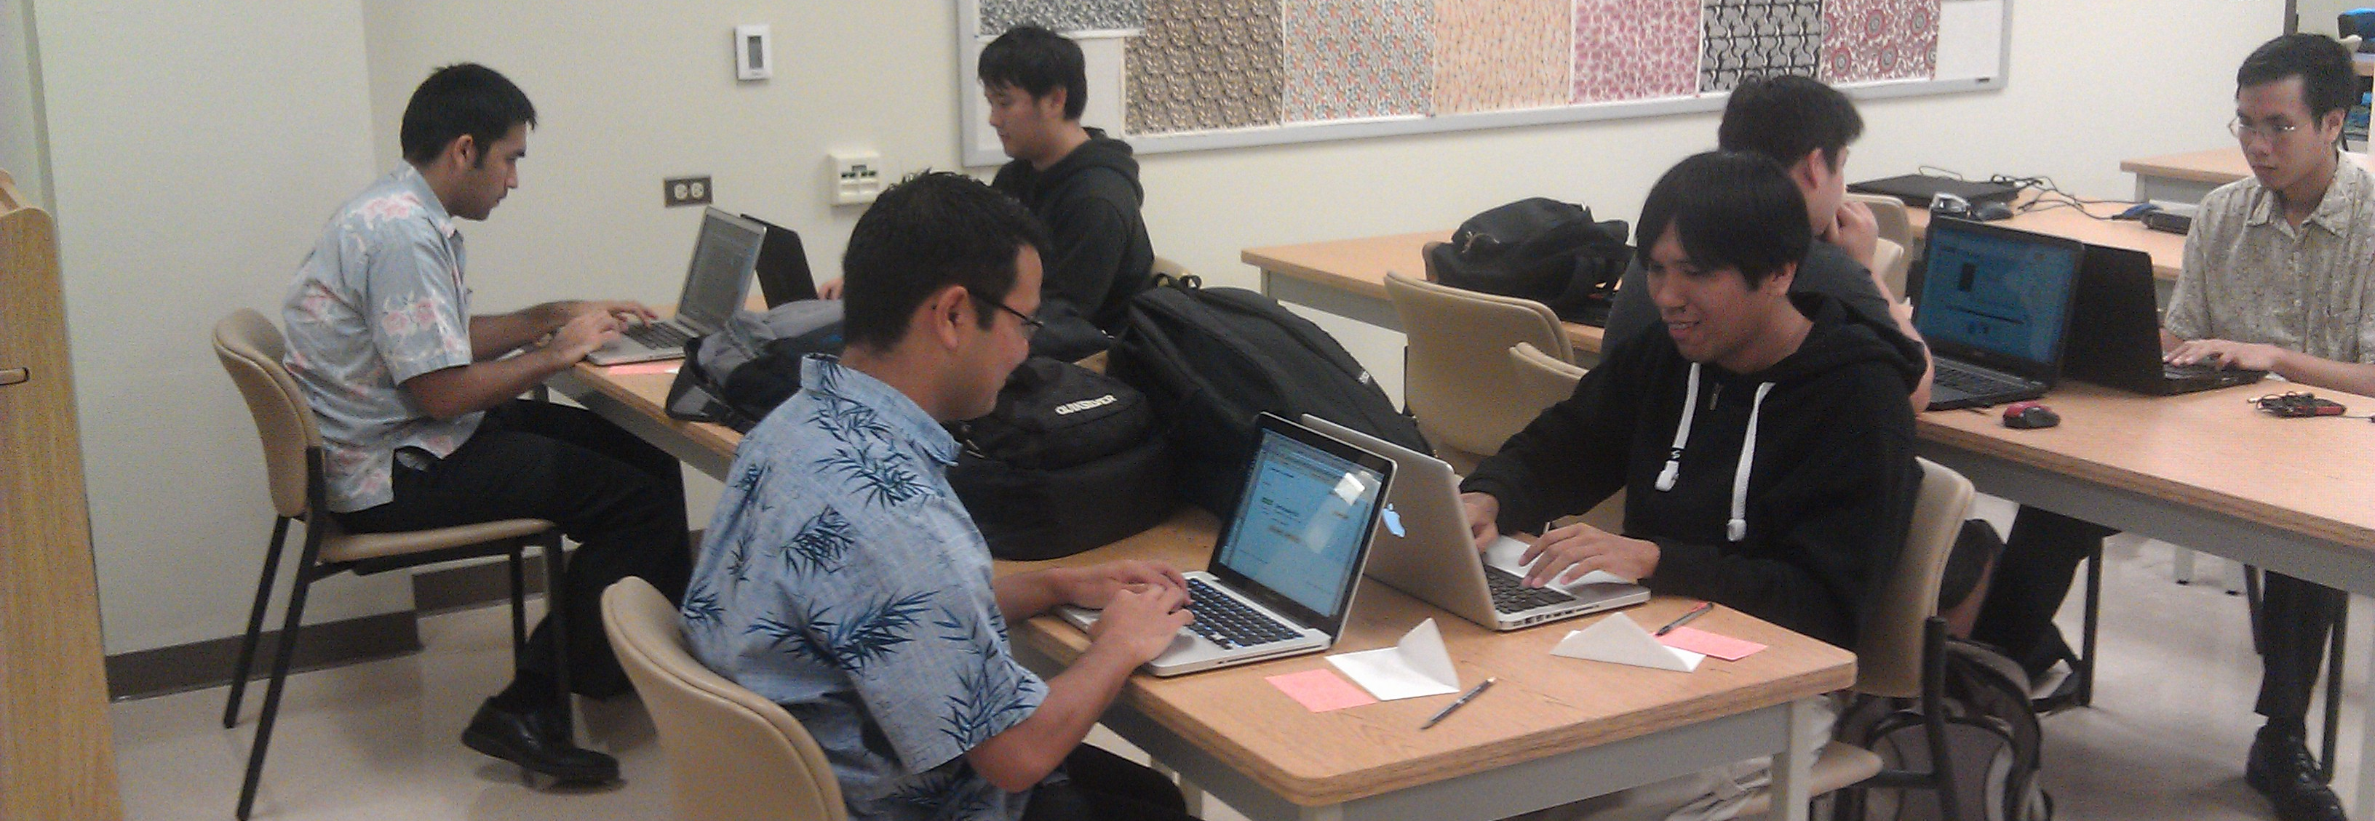
Students race against the clock
to finish WOD correctly

Slide 46
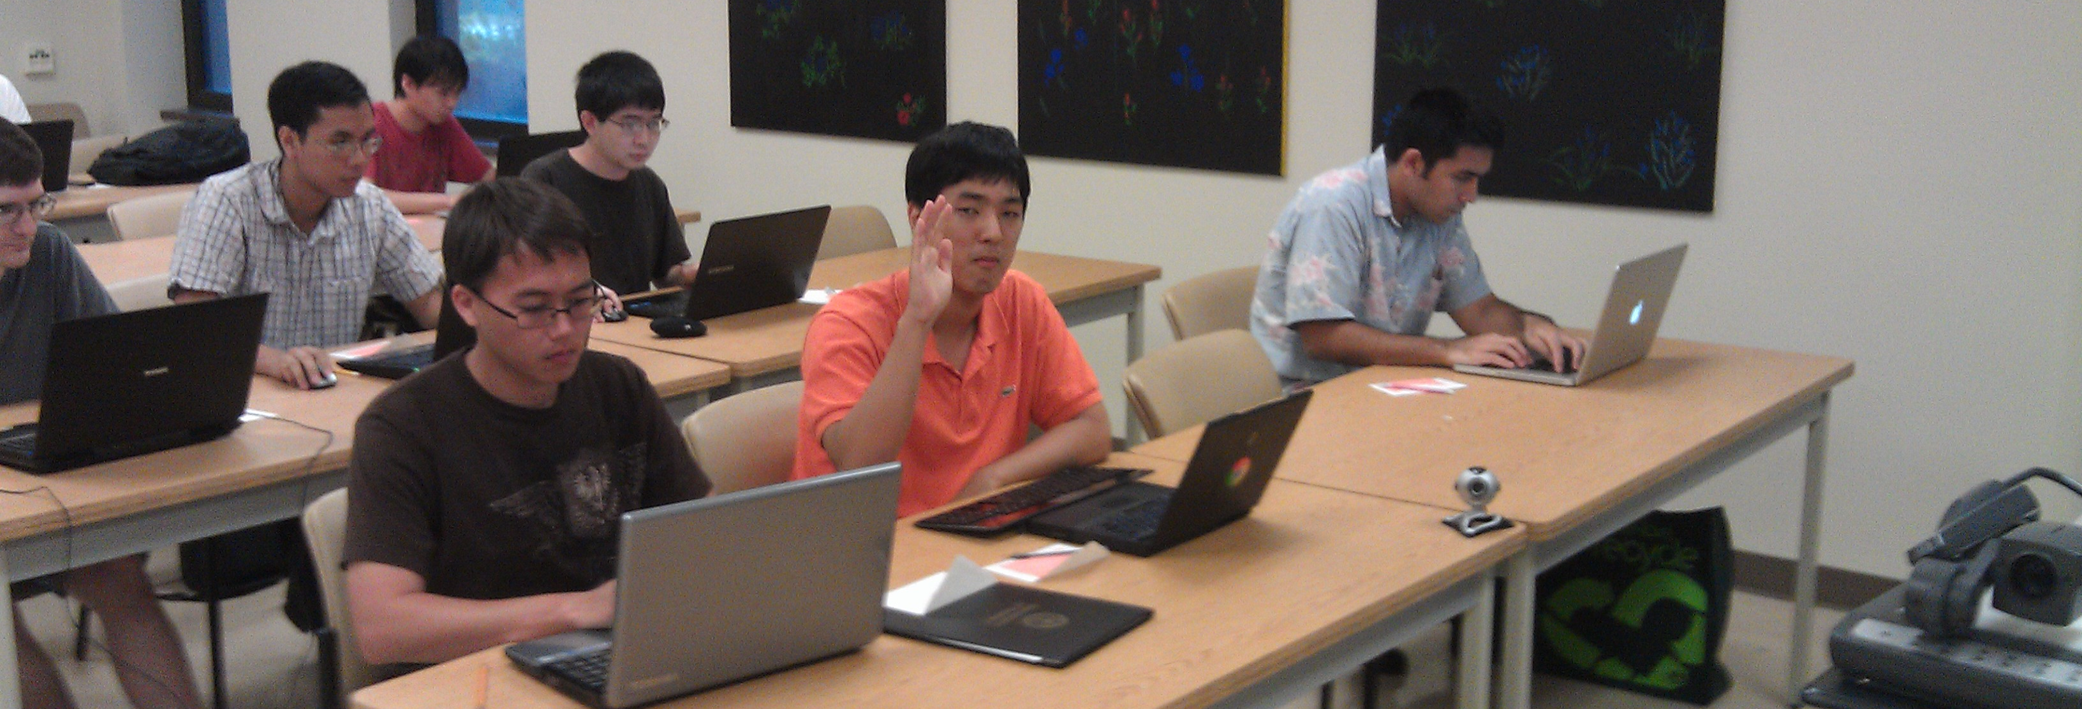
When finished, students raise hand
I record elapsed time on their card

Slide 47
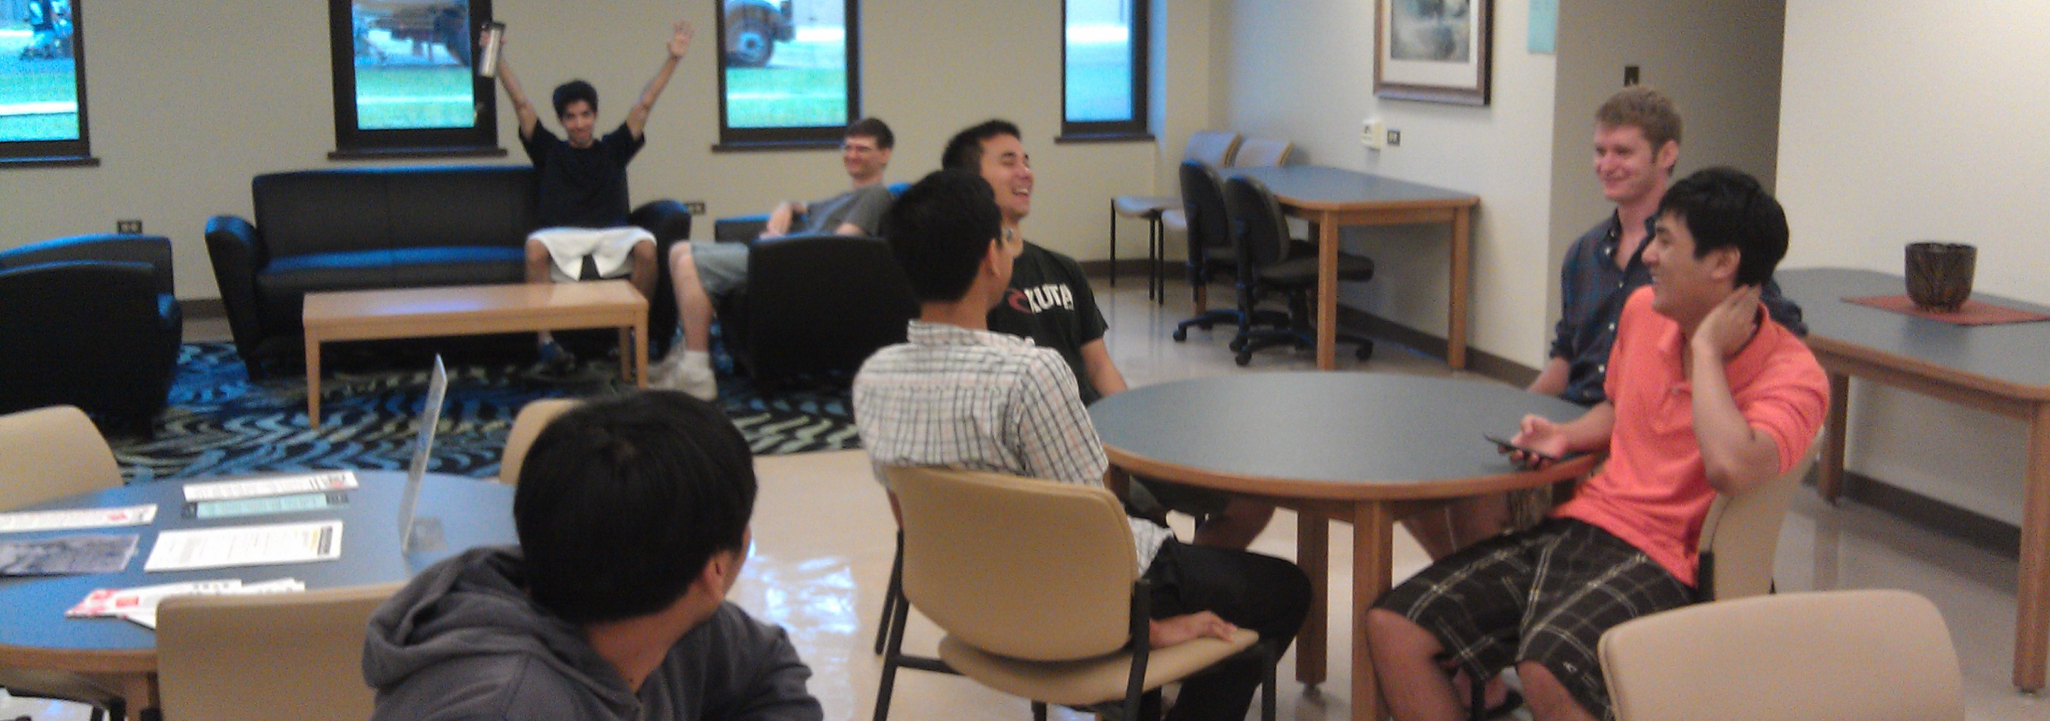
Early finishers wait outside
An informal "Winners Circle"

Slide 48
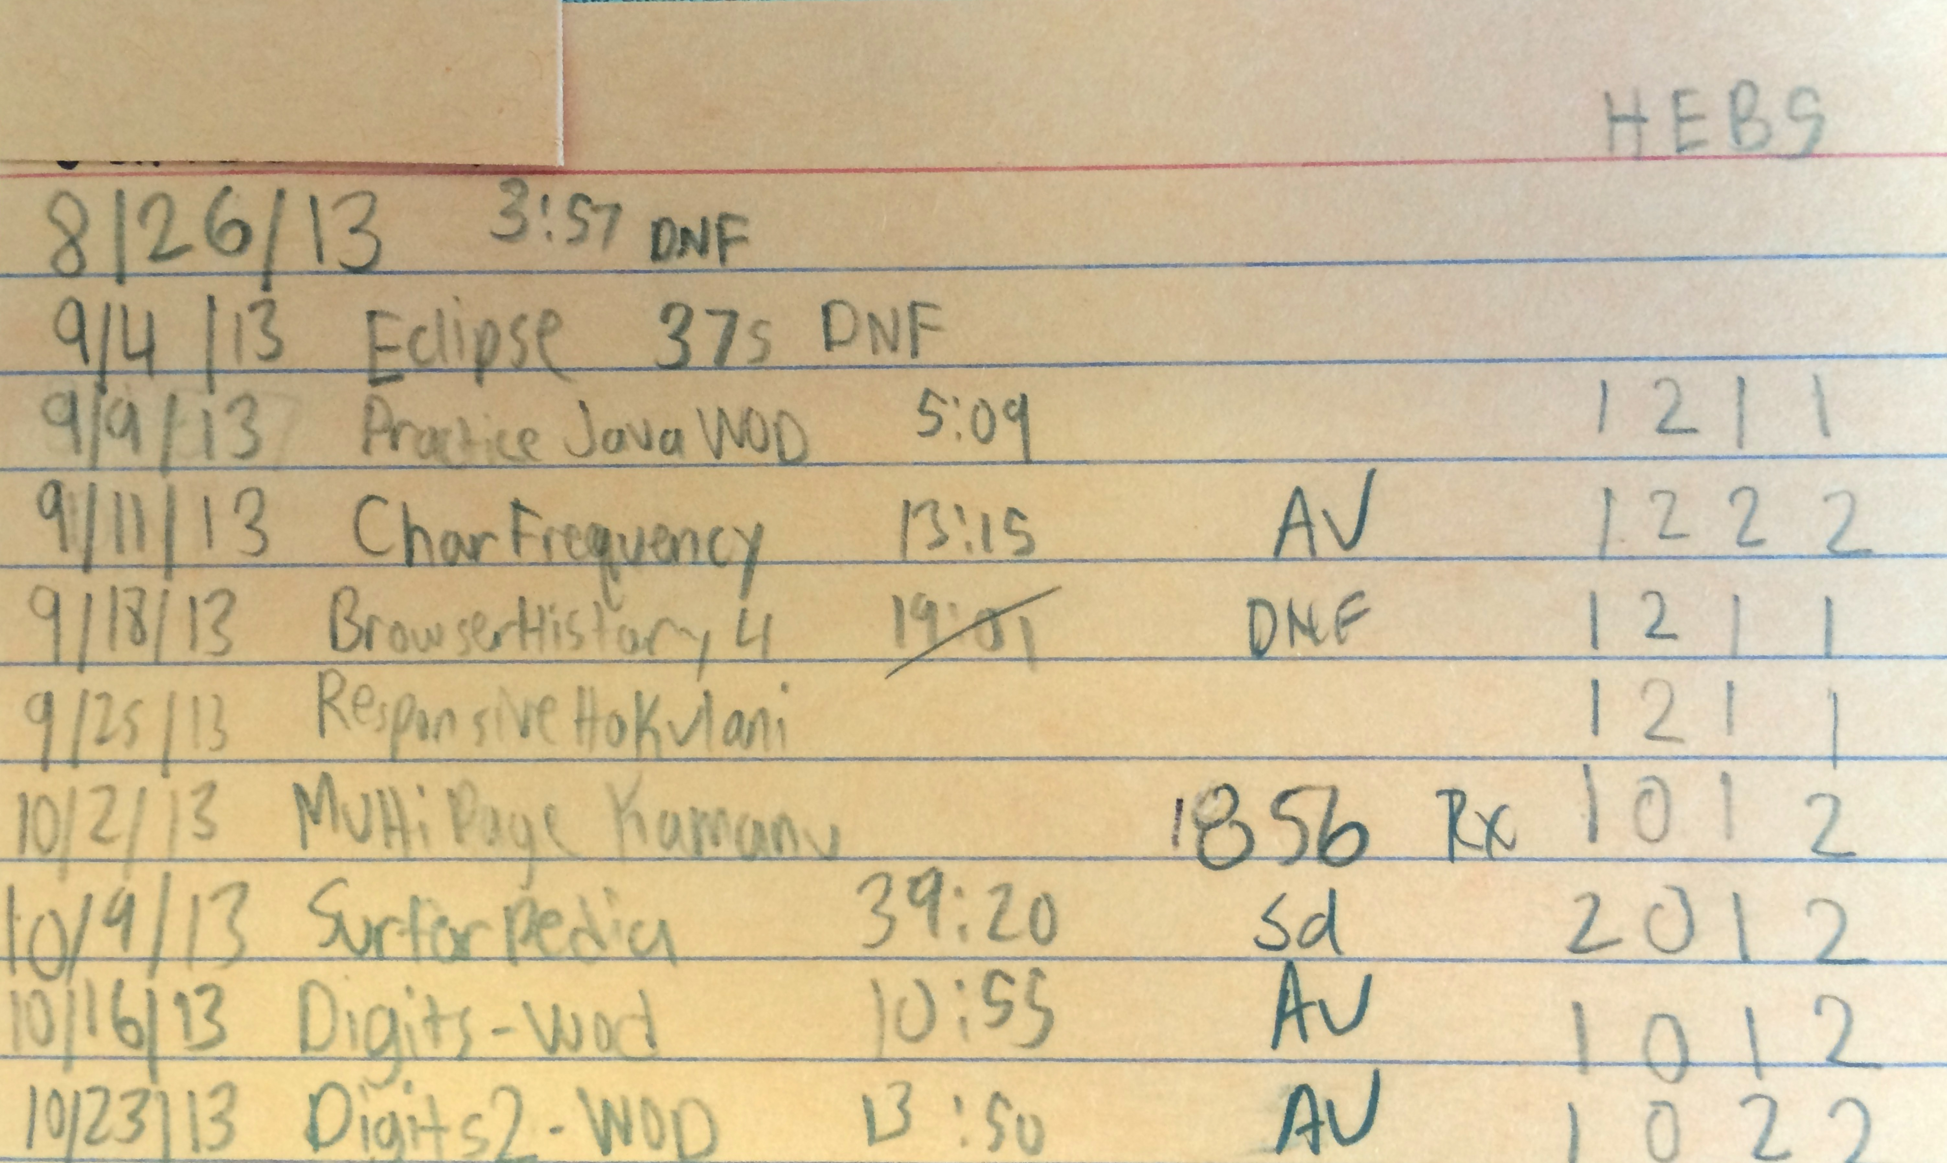
After class, I check submission
If incorrect, "DNF", no credit

Slide 49
3 Steps to Athletic Learning
1. Design a sequence of modules providing "skills" to be mastered.
2. For each module, provide students with:
sample problems requiring use of a skill
solution videos to each problem showing "mastery" of skill, time needed when "fluent"
3. Assess mastery through an in-class test where students are given a new problem to solve in a limited amount of time.

Slide 50
So how did this work out?

Slide 51
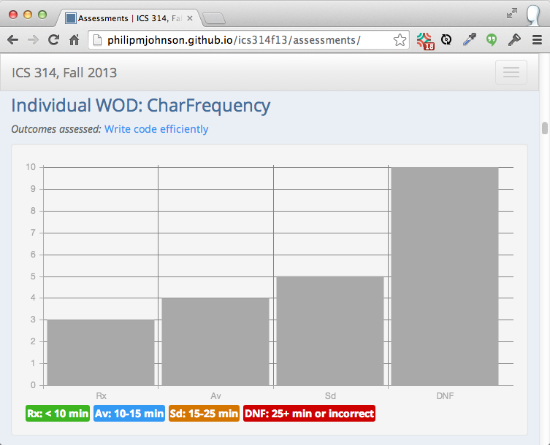
Outcome: WODs are stressful...

Slide 52
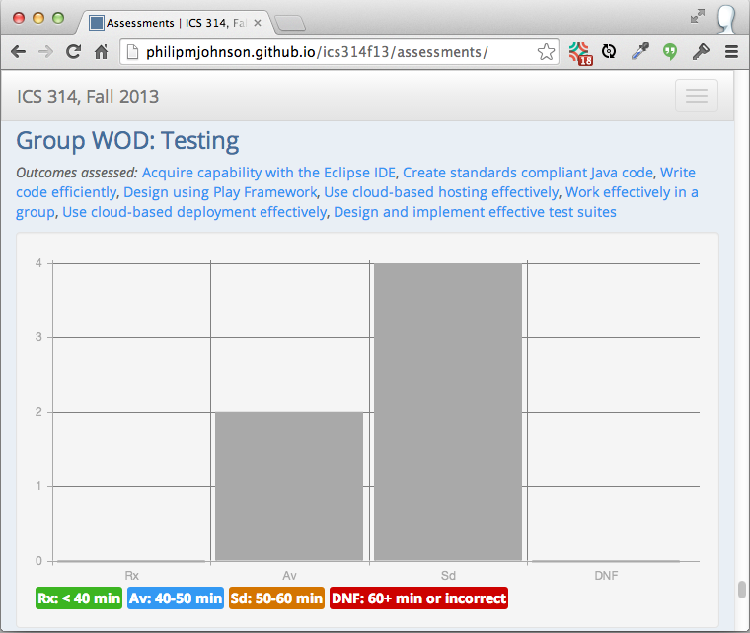
... but humans habituate

Slide 53
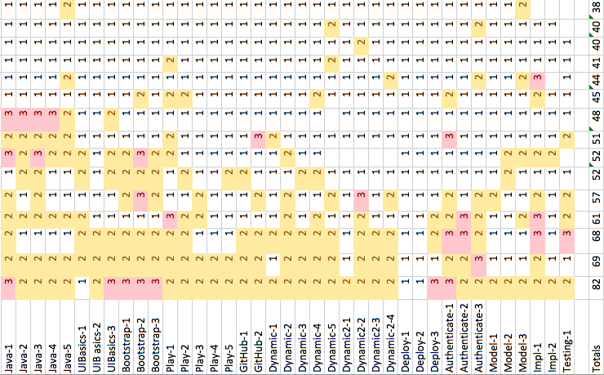
Outcome: Students practiced!

Slide 54
Practice WOD statistics
Every student repeated at least one practice WOD.
Over half the students repeated at least 12 practice WODs.
One student made 82 attempts at the 39 practice WODs.

Slide 55
For the first time in 25 years, students solve my homework assignments multiple times.

Slide 56

Outcome: Increased confidence
50% participation, up from 0% in 2012

Slide 57
Outcome: students like it
100% of the students prefer athletic approach to traditional course structure

Slide 58
Student Evaluations
"I learn more this way due to having to remember what I’ve done rather than searching how to do something and then forgetting soon after."

Slide 59
Student Evaluations
"During my initial attempt at the WODs, I may implement a solution that achieved the goal but was inefficient or poorly coded.
Being able to watch the solution and repeat the WODs helped to solidify the material we were learning."

Slide 60
Student Evaluations
"The in-class WODs simply reinforced what I should have practiced beforehand.
Whenever I DNF’ed an in-class WOD it was because I didn’t practice enough beforehand. "

Slide 61
Student Evaluations
"I think the WODs did inadvertently produce competitive feelings but it was not a negative feeling.
Rather, it was a great way to push me to work harder if I felt that I was lagging behind my fellow classmates."

Slide 62
Preliminary Lessons Learned
Changes course design:
Skill acquisition
Instructor demonstrates mastery
Time is constrained resource

Slide 63
Preliminary Lessons Learned
Students must:
Focus on fluency
Solve problems under pressure
Not need google

Slide 64
Preliminary Lessons Learned
Contra-indicated for:
Open-ended "research"
Customer interaction
Soft skill development

Slide 65
What about next time?
How do I reuse and improve my Fall 2013 curriculum material?
How do I make it accessible to other teachers?

Slide 66
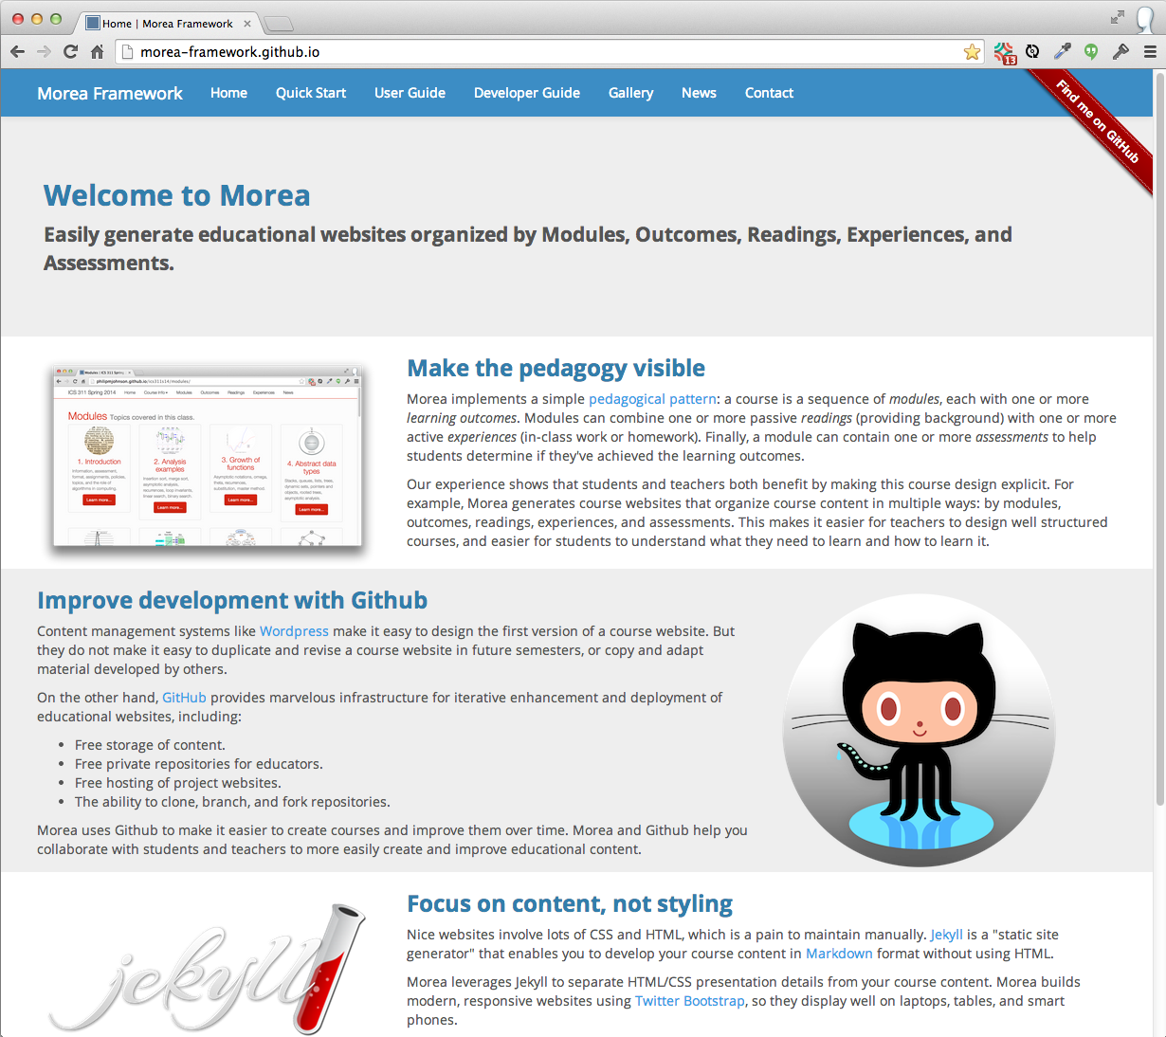

Slide 67
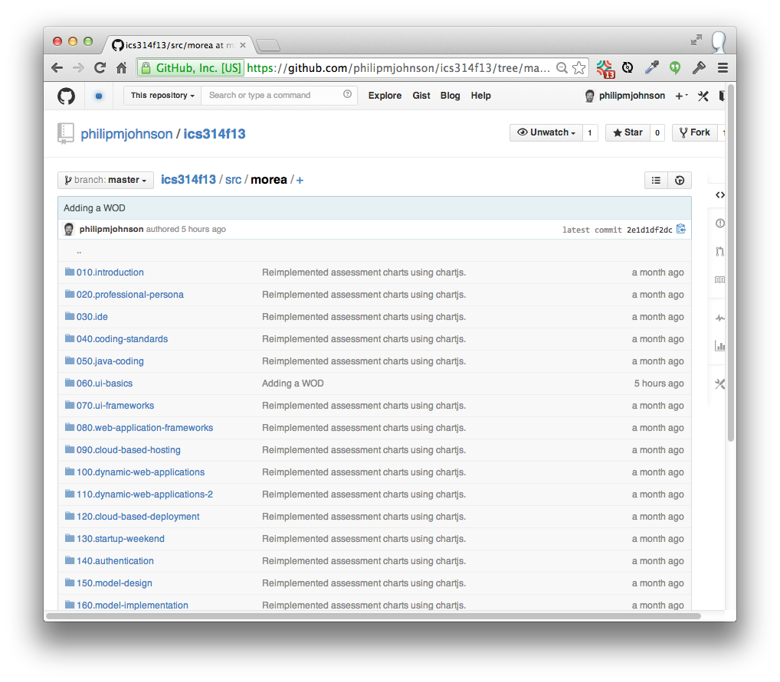

Slide 68
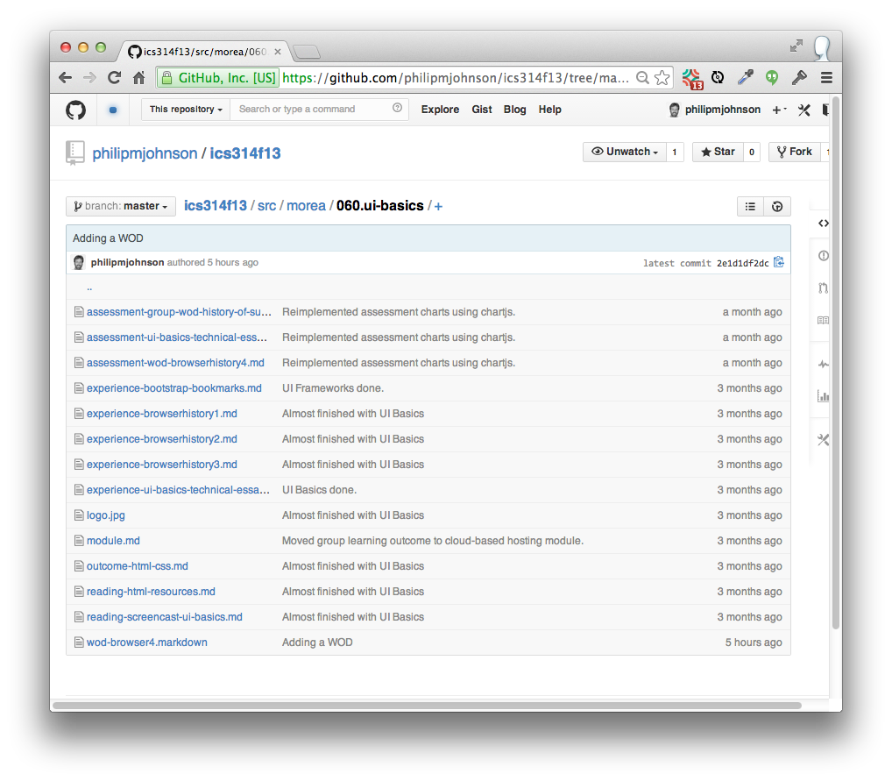

Slide 69
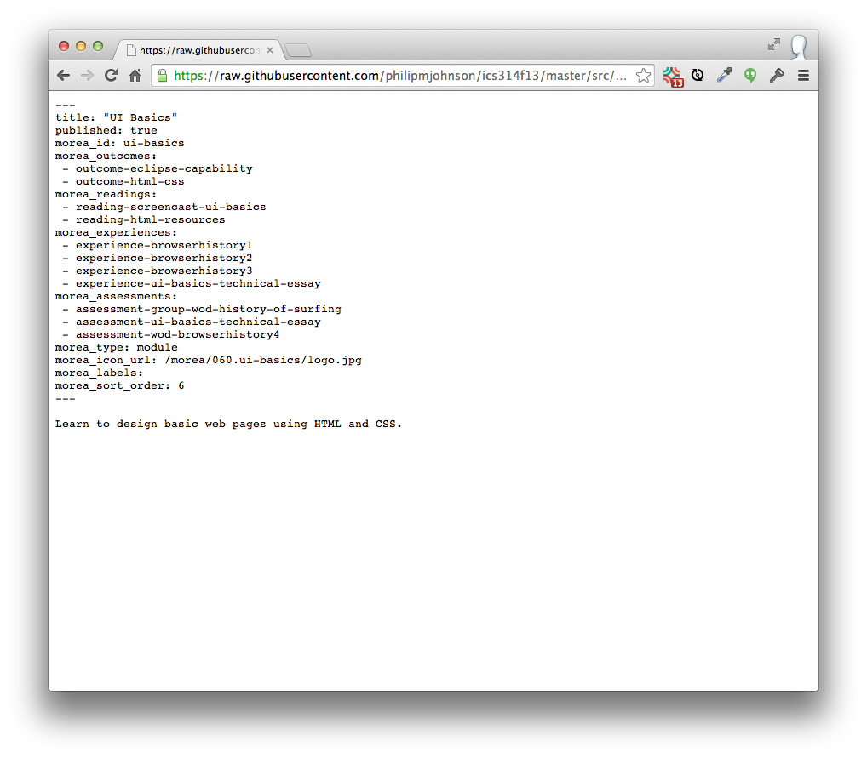

Slide 70

Modules
Outcomes
Readings
Experiences
Assessments

Slide 71
Recap: Bloom's Taxonomy
Capabilities
Create
Deep
Evaluate
Analyze
Apply
Understand
Remember
Shallow

Slide 72
Recap: Bloom's Taxonomy
Capabilities
Techniques
Teach others
Create
Deep
Practice by doing
Evaluate
Discussion group
Analyze
Demonstration
Apply
Audio-Visual
Understand
Lecture/Reading
Remember
Shallow

Slide 73
Recap: Learning outcomes
New ways to experiment on your students in the classroom
Google "athletic software engineering"
A simple, open source technology for building course web sites
Google "Morea Framework"

Slide 74
Thank you!

Slide 75
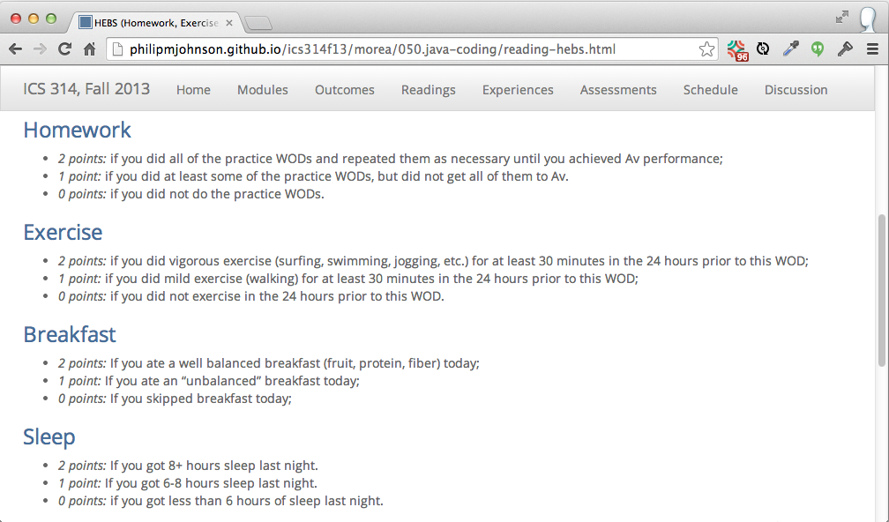
HEBS

Slide 76
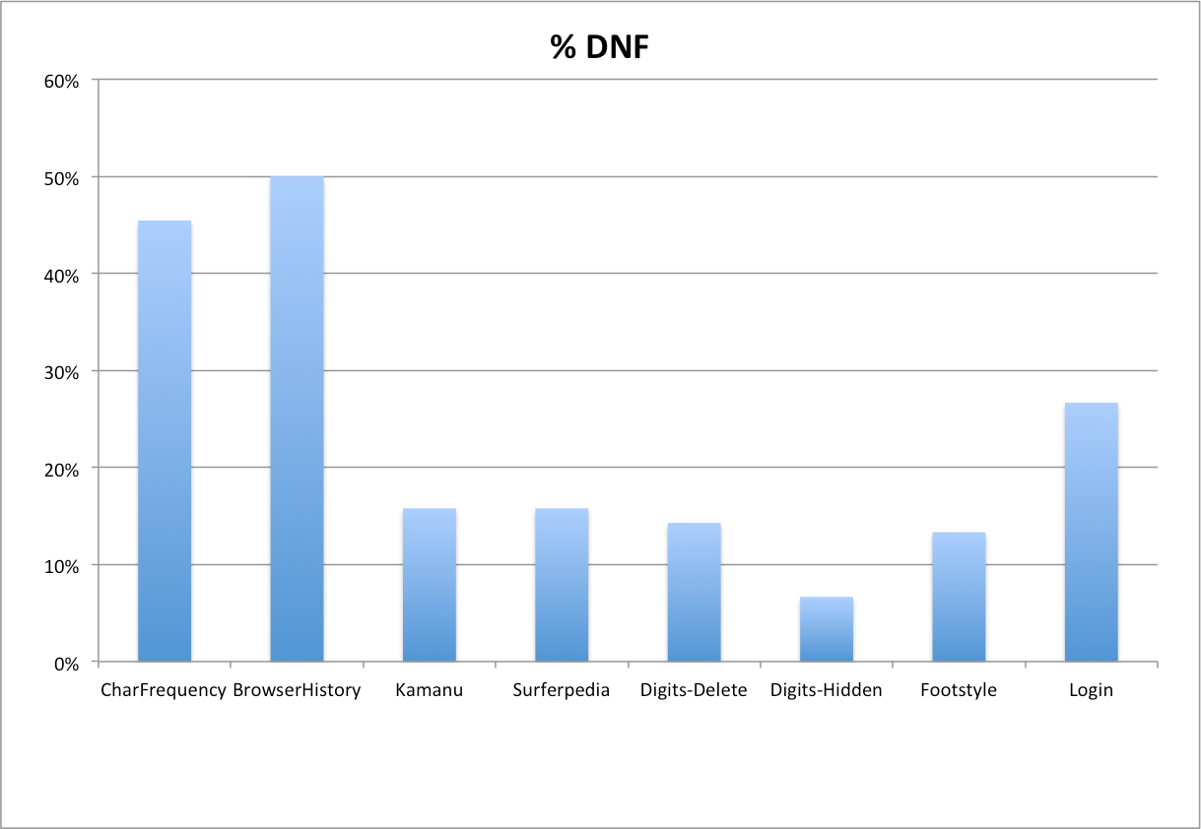
WOD DNF Trends

Slide 77
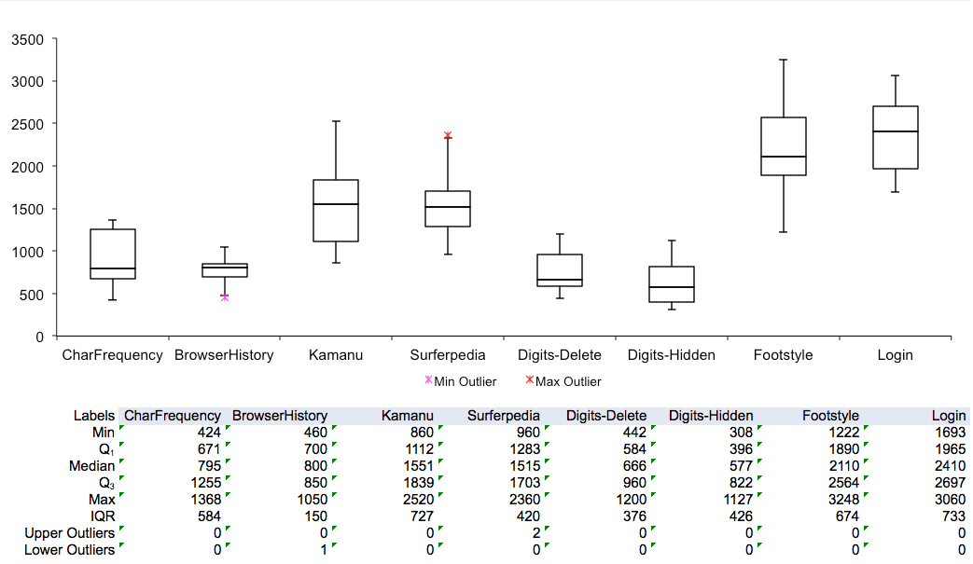
WOD elapsed time trends

Slide 78


Slide 79
